Slide 1
Parasite Egg ID
Vet Science Judging

Slide 2
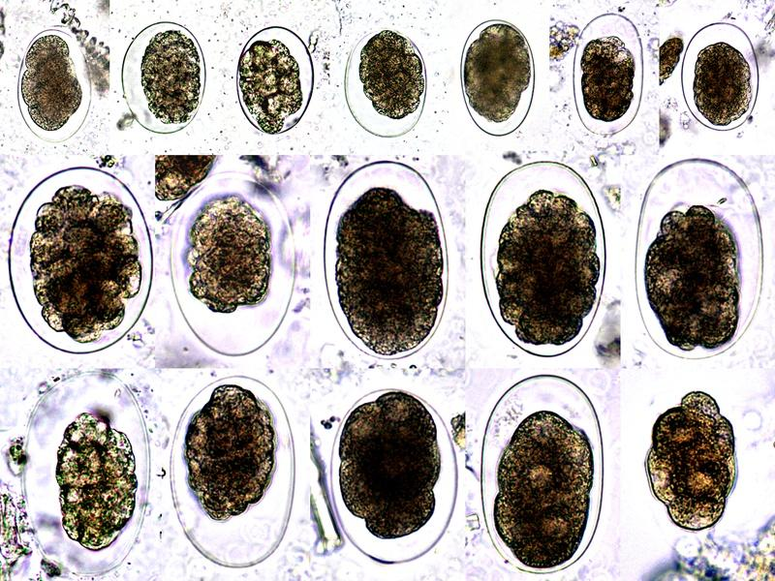
Hookworm Egg:

Slide 3
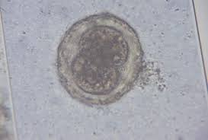
Roundworm Egg

Slide 4
Whipworm Egg

Slide 5
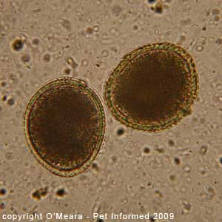
Roundworm Egg

Slide 6
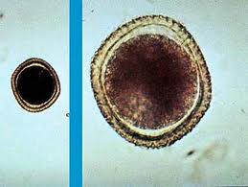
Roundworm Egg

Slide 7
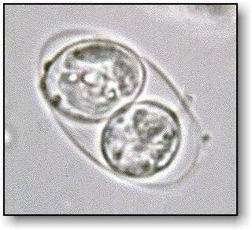
Coccidia

Slide 8
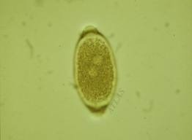
Whipworm Egg

Slide 9
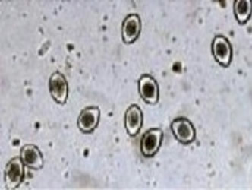
Coccidia

Slide 10
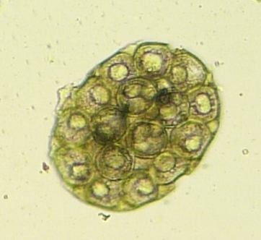
Flea Tapeworm Egg

Slide 11
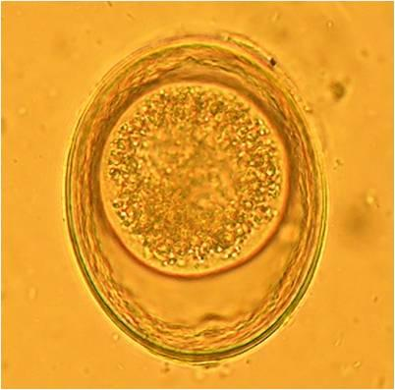
Roundworm Egg

Slide 12
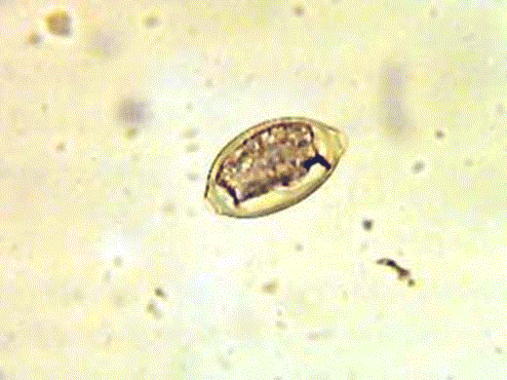
Whipworm Egg

Slide 13
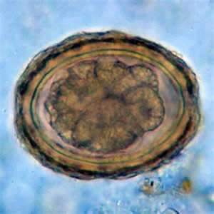
Roundworm Egg

Slide 14
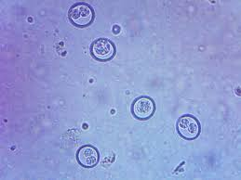
Coccidia

Slide 15
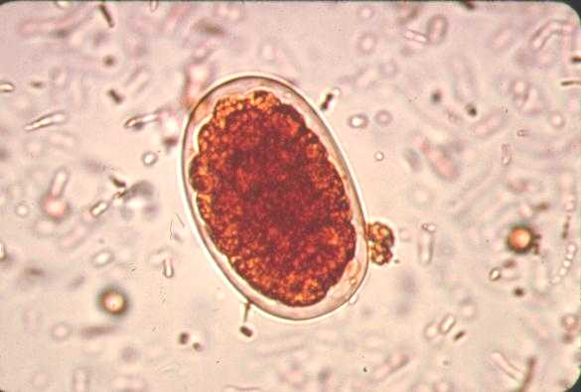
Hookworm Egg

Slide 16
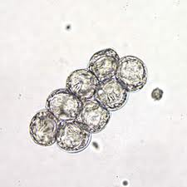
Flea Tapeworm Egg

Slide 17
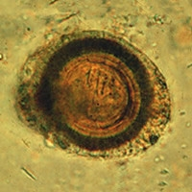
Taenia Tapeworm Egg

Slide 18
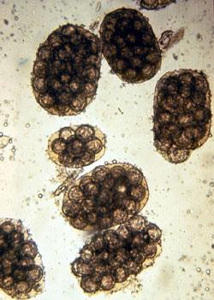
Flea Tapeworm Egg

Slide 19
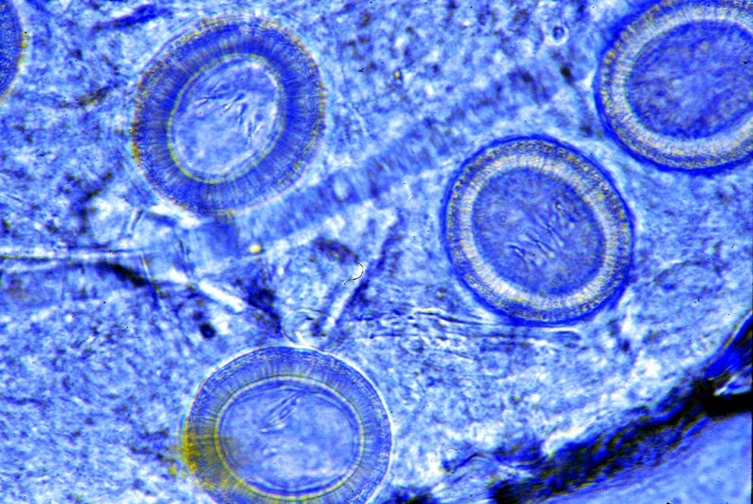
Taenia Tapeworm Egg

