Slide 1
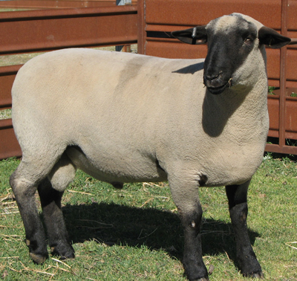
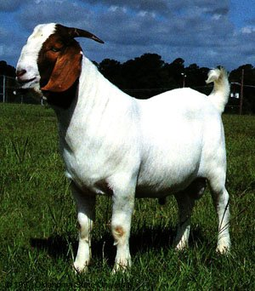
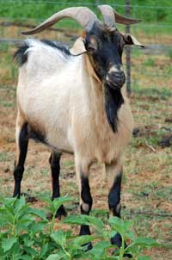
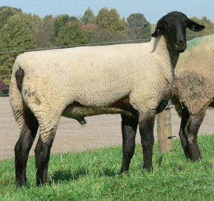
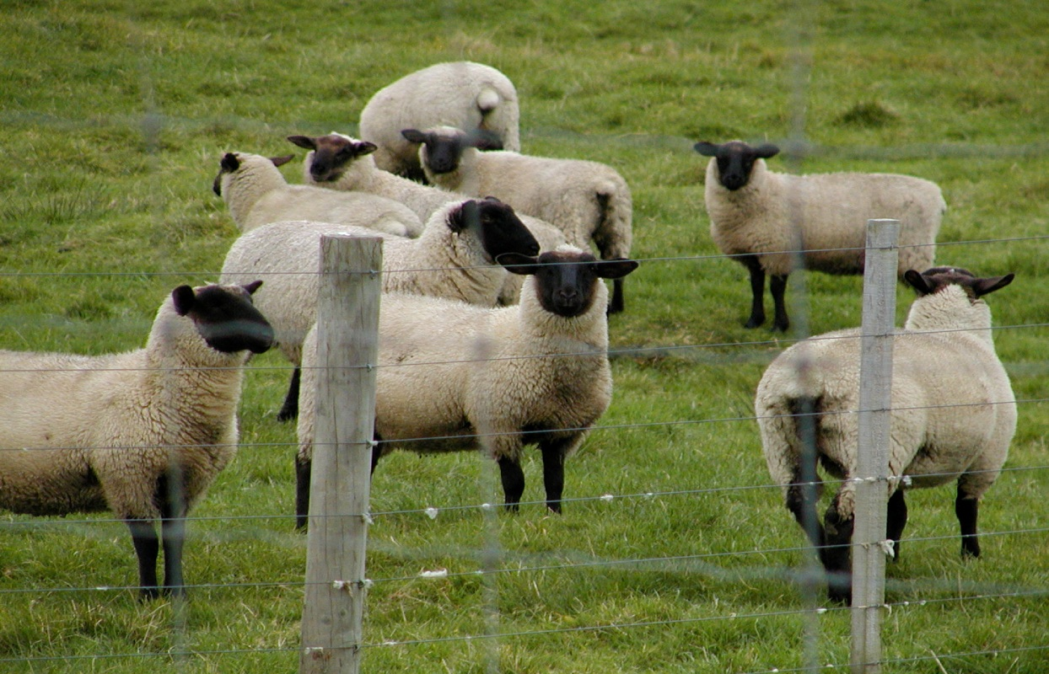
Sheep & Goat Breeds

Slide 2
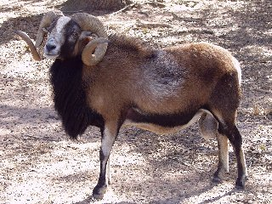
Barbado
Developed in Texas
Cross of Barbados Blackbelly and Rambouillet
Tan, tan with a pale or black belly, or pied
Primarily used as trophy game due to its large curled horns

Slide 3
Columbia
Developed in the United States
Foundation of Lincoln rams on Rambouillet ewes
Largest of the crossbred breeds
White faced, polled breed

Slide 4
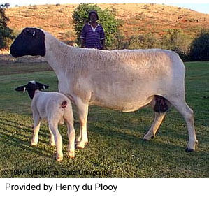
Dorper
From South Africa
Thick skin that is made up of hair and wool
Extremely adaptable with a high ability to flourish, grow and produce and reproduce in irregular and low rainfall events

Slide 5
Dorset
Originated in England
Horned and polled strains
Ability to breed out of season
White-faced sheep that produce a light shearing, open fleece

Slide 6
Hampshire
Originated in England
Rapid growth and muscularity
Dark brown to black face and legs with a wool cap on head

Slide 7
Rambouillet
Originated in France
Dominant range ewe in the western United States
White-faced breed that is not extremely prolific under range conditions

Slide 8
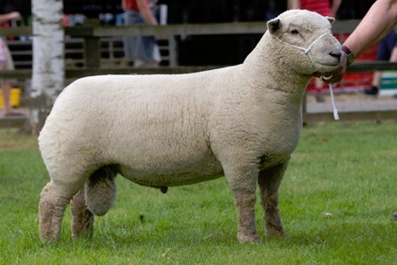
Southdown
Originated in England
One of the oldest sheep breeds
Medium to small sized with light brown face and legs
Produce meaty, light weight carcasses
Low maintenance breed

Slide 9
Suffolk
Originated in England
Black head and legs which are free of wool
Alert, active sheep that grow very fast and produce lean, muscular carcasses

Slide 10
Angora
Originated in Turkey
Produces mohair
Over 90% of the nation’s Angora goats reside in Texas, primarily in the Edward’s Plateau.

Slide 11
South African Boer
Originated in Africa
Medium sized with prominent horns and broad, drooping ears
Brown head and neck with white body
Valued for meat production

Slide 12
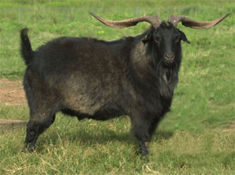
Spanish Goat
Originated in Spain
Horned, any color or color pattern.
Very prolific
Tolerant of harsh conditions
Relatively resistant to parasites
Used for clearing brush and meat production

