Slide 1
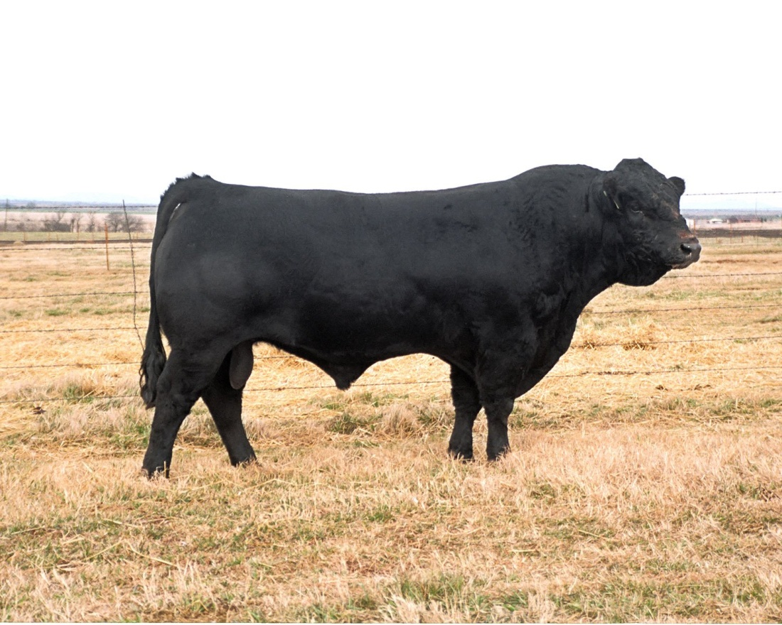
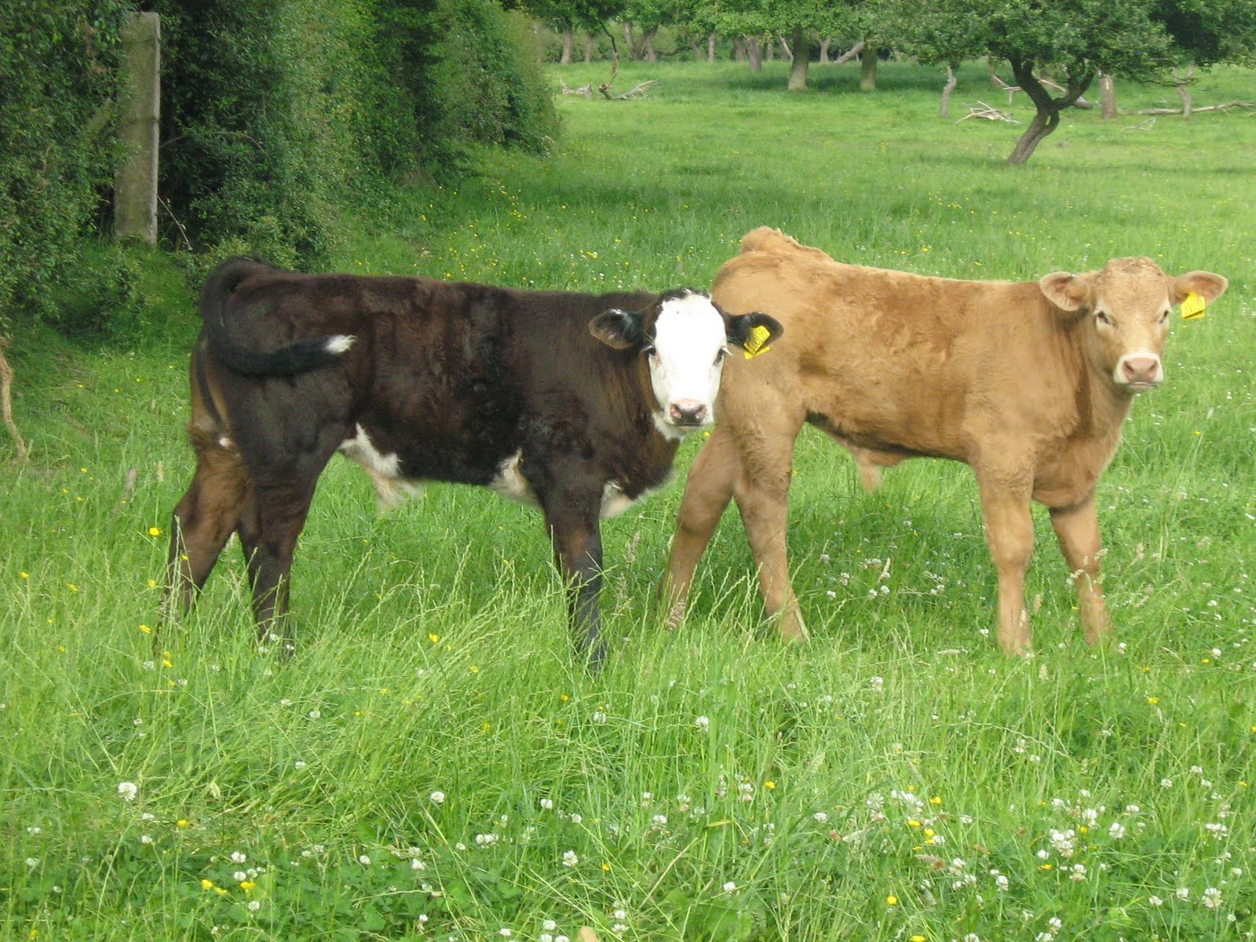
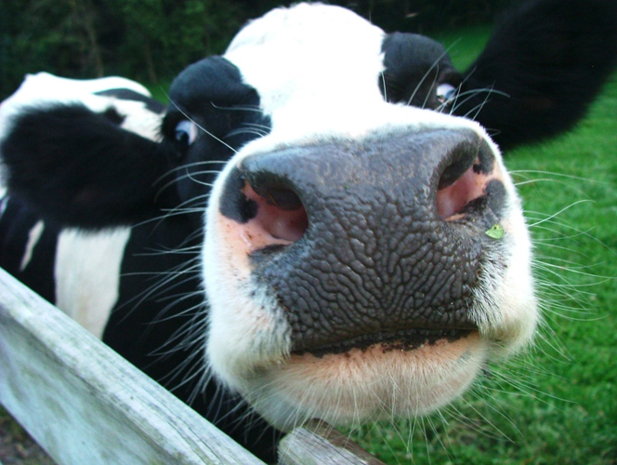
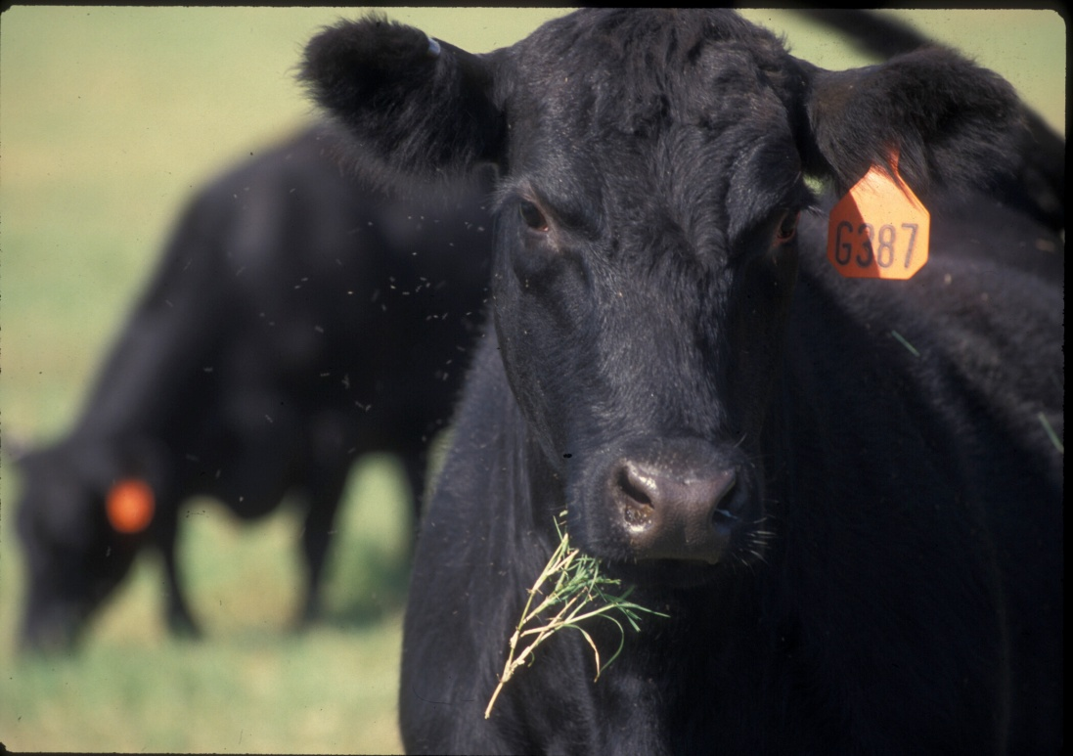
Cattle Breeds

Slide 2
Angus
Originated in Scotland
Black, naturally polled
Largest number of annual registrations in the United States

Slide 3
Ayrshire
Originated in Scotland
Medium sized breed
Medium to dark red and white in color
Average lactation 305 days of 14,534 lbs. milk

Slide 4
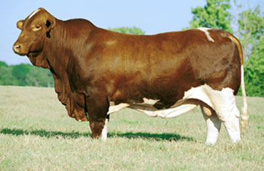
Beefmaster
Developed in the United States
About 50% Brahman, 25% Shorthorn and 25% Hereford
No set color pattern

Slide 5
Belted Galloway
Distinctive white belt that often varies somewhat in width and regularity, but covers most of the body from the shoulders to the hooks
Black coat with white contrast, which may turn brownish in the summer

Slide 6
Braford
3/8 Brahman and 5/8 Hereford
Superior maternal ability
Red like a Herford with white underbelly, head and feet.

Slide 7
Brahman
Originated in India
Red and grey strands
Noted for heat tolerance, disease and insect resistance and crossing ability

Slide 8
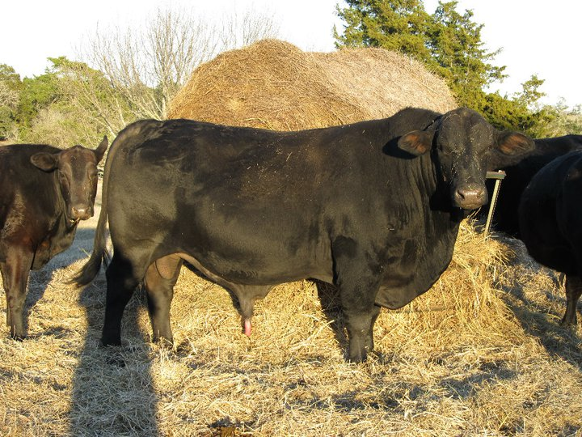
Black Brangus
Developed in the United States
5/8 Angus and 3/8 Brahman, black and naturally polled

Slide 9
Braunvieh
Various shades of brown, predominately mousy brown, but ranging from light brown with gray to very dark brown.
Border of the muzzle is very light as is the poll. Switch of the tail is dark brown to black. Skin is pigmented, the muzzle is black and hooves are dark

Slide 10
Brown Swiss
Originated in Switzerland
Large docile breed
Hair is brown of various shades
Average lactation 305 days of 16,135 lbs. of milk

Slide 11
Charolais
Originated in France
White, off-white to cream coloration
Produce lean, muscular carcasses
Below average maternally

Slide 12
Gelbvieh
Originated in Germany
Reddish gold to russet colored hair
Resulted from government controlled breeding program (W. Germany)
Dual purpose breed

Slide 13
Guernsey
Originated on the Isle of Guernsey
Medium size breed know for gentle nature
Various shades of fawn with white markings and a white switch
Average lactation 305 days of 13, 109

Slide 14
Hereford
Originated in England
Red and white, also white on underline, legs, switch etc.
Found in all 50 states

Slide 15
Holstein
Originated in the Netherlands
Dominant breed of dairy cattle
Black and white color pattern (red and white exist)
Average lactation 305 days of 20,121 lbs. of milk

Slide 16
Jersey
Originated on the Isle of Jersey
A small, refined animal of unsurpassed femininity
Vary from light tan to dark fawn with darker shading around the head and lower legs
Average milk yield of 13,358

Slide 17
Limousin
Originated in France
Reddish gold in color, can also be black
Fastest growing breed in country (percentage increase in registrations)

Slide 18
Maine Anjou
Originated in France
Deep red in color with white underline and patches, can also be black
Largest continental breed in terms of weight

Slide 19
Polled Hereford
Developed in the United States
Red with white face, also white on underline, legs, switch, etc.
Naturally hornless

Slide 20
Red Angus
Developed in the United States
Red and naturally polled
Developed from a recessive gene found in black Angus cattle

Slide 21
Red Brangus
Produced by mating black Angus cows and grey Brahman bulls
Always red

Slide 22
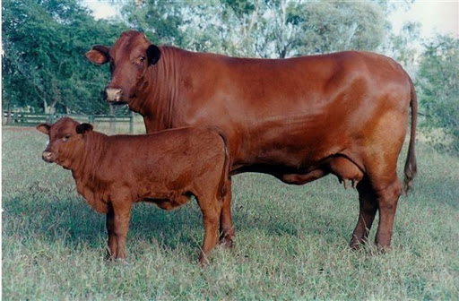
Santa Gertrudis
Developed in the United States
5/8 Shorthorn and 3/8 Brahman
Dark red, both horned and polled

Slide 23
Shorthorn
Originated in England
Three main colors: red, white and roan
Used for milk and meat

Slide 24
Simmental
Originated in Switzerland
Range in color from straw colored through light red and dark red, also black
Heaviest milking continental breed

Slide 25
Texas Longhorn
Developed in Texas, of Spanish origin
Long, distinctive horns, many colors including speckled and spotted

