Slide 1
Instruments

Slide 2
Alligator Forceps

Slide 3
All-in-one castrator, docker and ear marker

Slide 4
Ambu Bag

Slide 5
artificial Vagina

Slide 6
Autoclave

Slide 7
Automatic dose syringe

Slide 8
Backaus towel forceps

Slide 9
Balling gun

Slide 10
Barnes dehorner

Slide 11
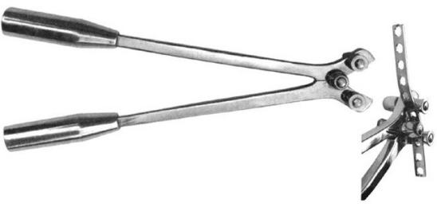
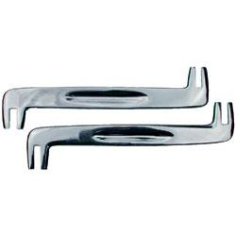
Bone Plate Bender
Notes:
Many different varieties used

Slide 12
Brown-Adson Tissue Forceps

Slide 13
Bulb syringe

Slide 14
burdizzo

Slide 15
Castroviejo needle holder with catch

Slide 16
Cornell teat curette

Slide 17
Dental rasp

Slide 18
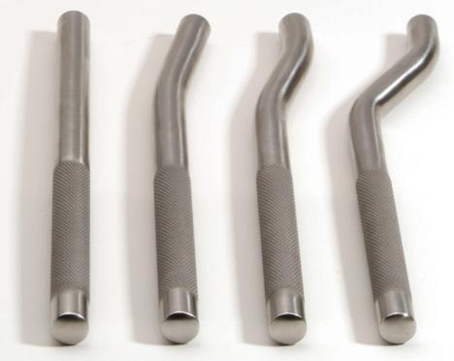
Dental Tooth Punch

Slide 19
Depth probe and explorer

Slide 20
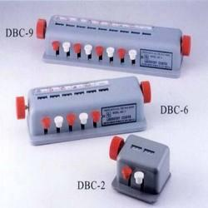
Differential cell counter

Slide 21
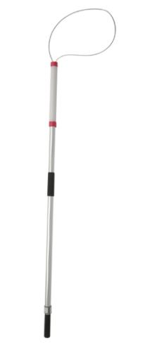
Dog snare or capture pole

Slide 22
Doppler ultrasonic blood flow monitor

Slide 23
Drench pump

Slide 24
Drench-matic dose syringe

Slide 25
Ear notcher

Slide 26
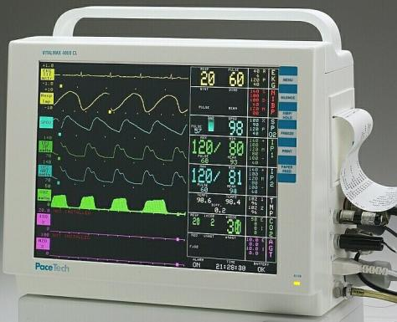
Ecg monitor

Slide 27
elastrator

Slide 28
Elizabethan collar

Slide 29
endoscope

Slide 30
Endotracheal tube

Slide 31
Esophageal stethoscope

Slide 32
Equine Molar Extracting forceps

Slide 33
Eye speculum

Slide 34
Fecal loop

Slide 35
Feline restraint bag

Slide 36
Fetal extractor (calf puller)

Slide 37
Forester sponger holding forceps

Slide 38
Groove director

Slide 39
Guillotine nail trimmer

Slide 40
Half circle taper point suture needle

Slide 41
Half curved cutting edge suture needle

Slide 42
Half curved tissue forceps

Slide 43
Halstead mosquito forceps

Slide 44
Hartman mosquito forceps

Slide 45
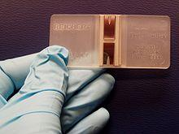
hemocytometer

Slide 46
Holzheimer retractor

Slide 47
Hoof trimmer for sheep and goats

Slide 48
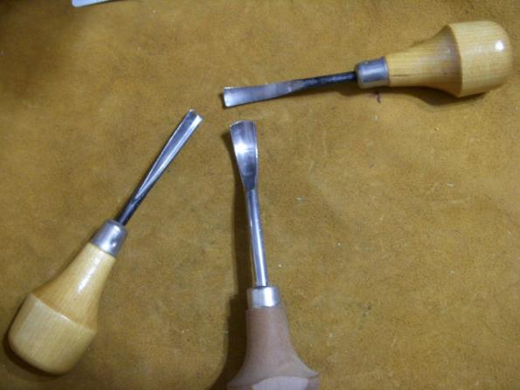
Horn gouge

Slide 49
Identification tag applicator

Slide 50
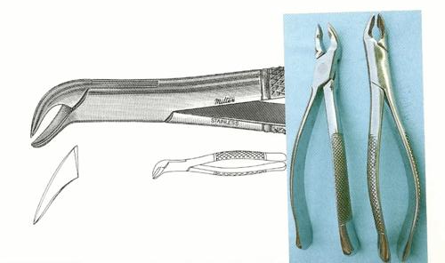
Incisor canine and premolar extracting forceps

Slide 51
Insemination pipette

Slide 52
Intravenous drip set

Slide 53
Iris hook

Slide 54
Jacquette tartar scaler

Slide 55
Kelly forceps

Slide 56
Killian vaginal speculum

Slide 57
Knowles bandage scissors

Slide 58
Lens loop

Slide 59
Lister bandage scissors

Slide 60
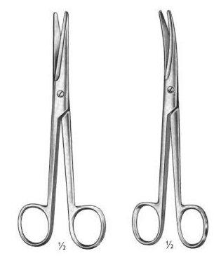
Mayo scissors

Slide 61
Mayo-hegar needle holder

Slide 62
Olsen-hegar needle holder-scissors combination

Slide 63
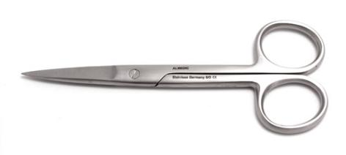
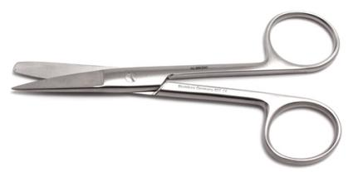
Operating scissors

Slide 64
Ophthalmoscope

Slide 65
Oral calf drencher

Slide 66
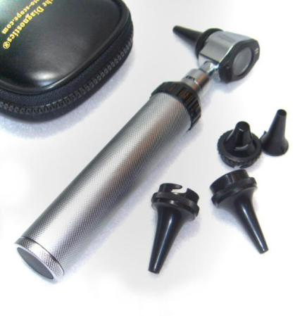
otoscope

Slide 67
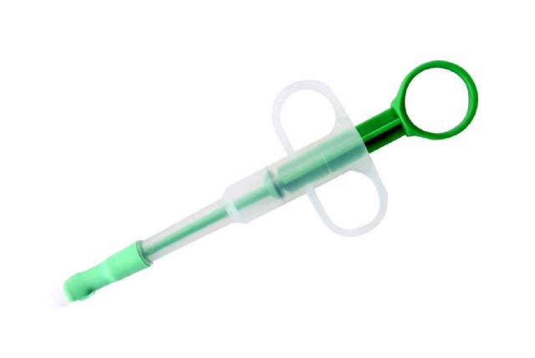
Pet piller

Slide 68
Pig tooth nipper

Slide 69
Pill splitter

Slide 70
Polansky canine vaginal speculum

Slide 71
Pole syringe

Slide 72
Rectal prolapse ring

Slide 73
refractometer

Slide 74
Reimer emasculator

Slide 75
Restraint gloves

Slide 76
Rumen magnet

Slide 77
Scalpel handle

Slide 78
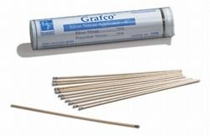
Silver nitrate stick

Slide 79
Spay hook

Slide 80
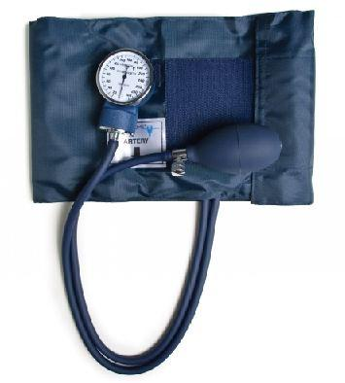
sphygmomanometer

Slide 81
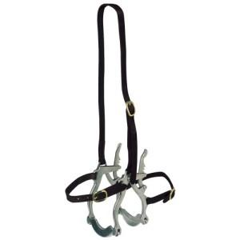
Spring mouth/Gag Speculum

Slide 82
stethosope

Slide 83
Stomach tube

Slide 84
Tarter scrapers single ended

Slide 85
Tattoo outfit manual

Slide 86
Taylor percussion hammer

Slide 87
Teat slitter

Slide 88
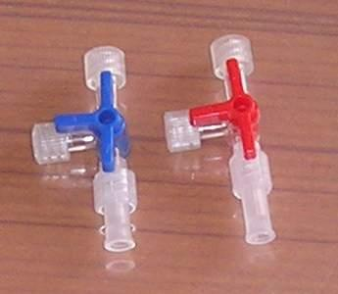
Three way stopcock

Slide 89
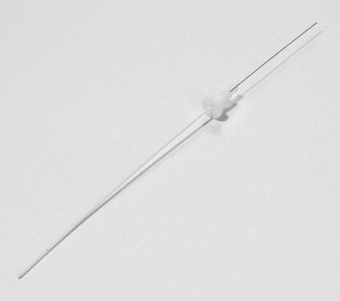
Tom cat catheter

Slide 90
Transfer needle

Slide 91
Twitch-chain

Slide 92
Twitch-humane

Slide 93
Umbilical clamp

Slide 94
Vetamatic dose syringe

Slide 95
White emasculator

Slide 96
White nail trimmer

Slide 97
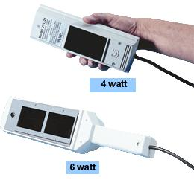
Woods (uv) light

Slide 98
X-ray measuring caliper

