Slide 1
Organ Identification Pictures
Supported by the National Institutes of Health ORIP

Slide 2
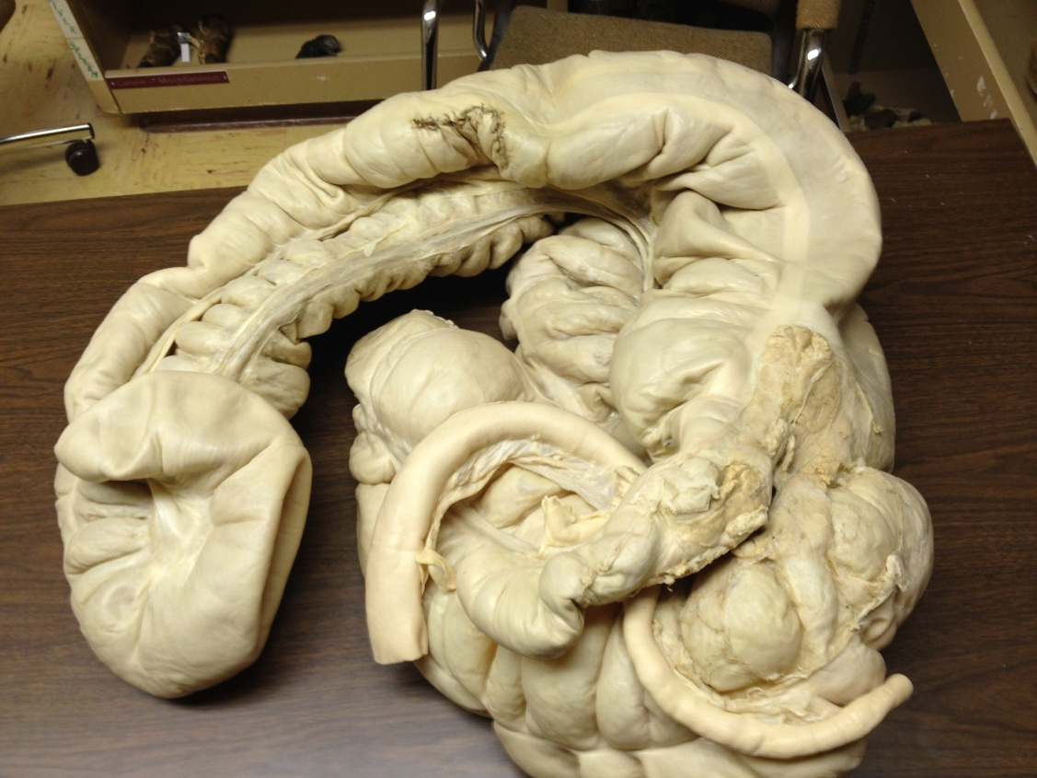
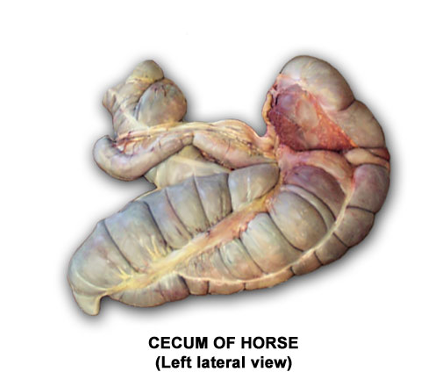
Cecum of Horse “Blind Pouch”
Large Intestine
Cecum
Small Intestine-Duodenum
Small Intestine (Ileum) entering large intestine

Slide 3
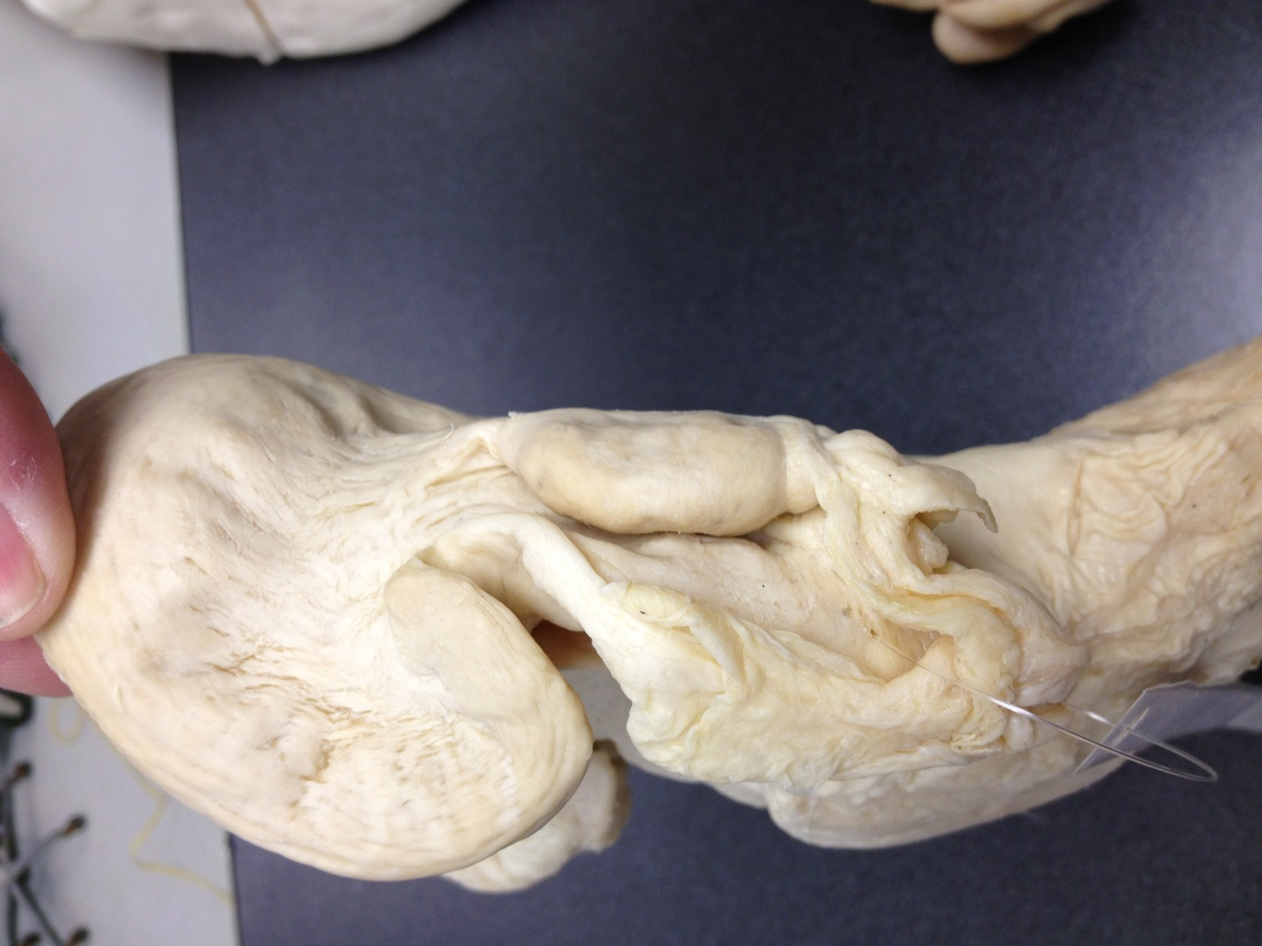
Ovary and Fallopian Tube-Bovine

Slide 4
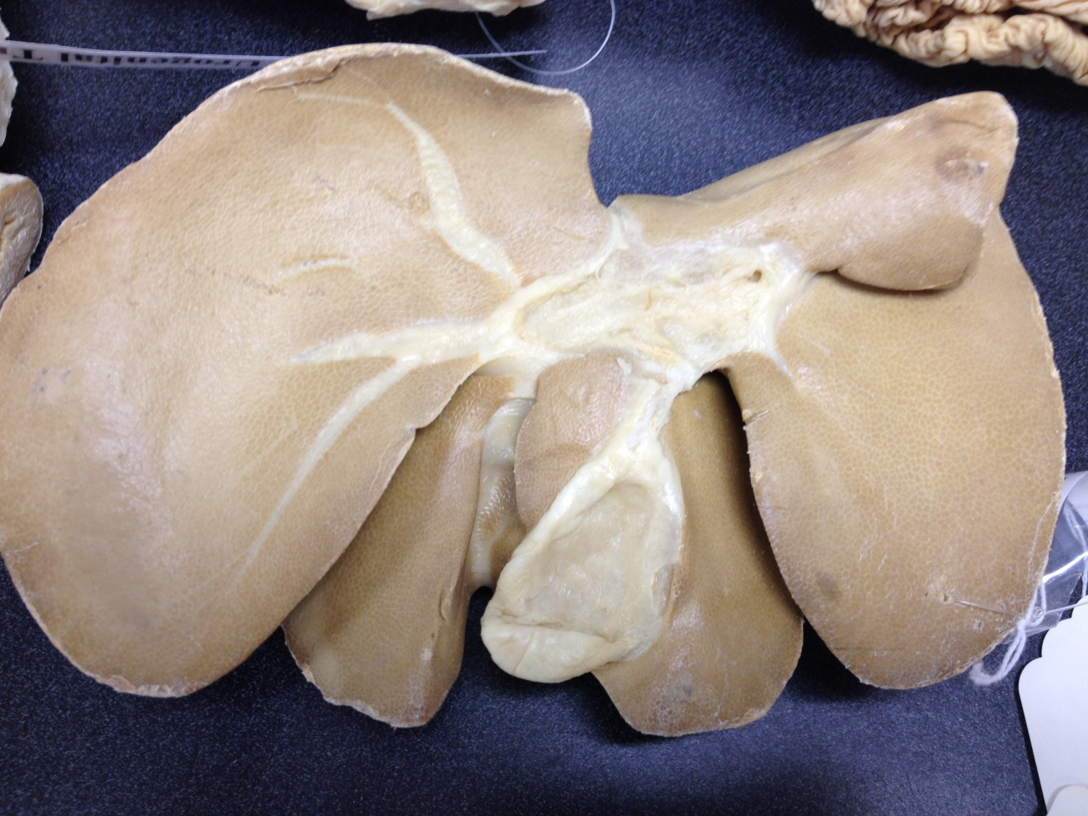
Liver and Gall Bladder

Slide 5
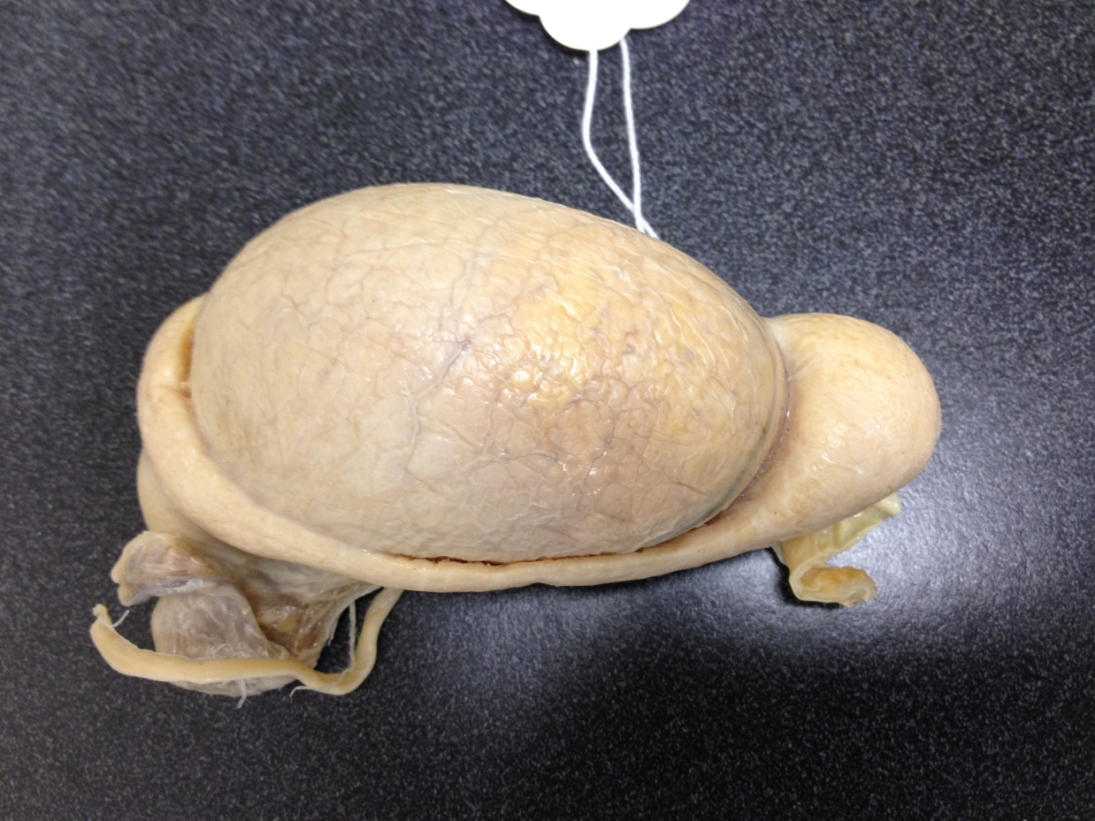
Testicle
Epididymis

Slide 6
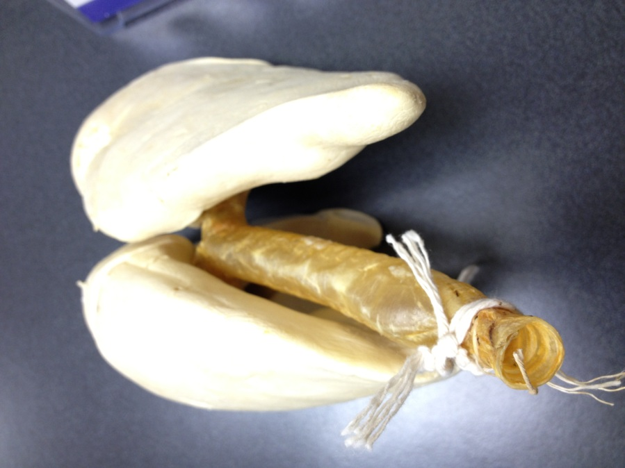
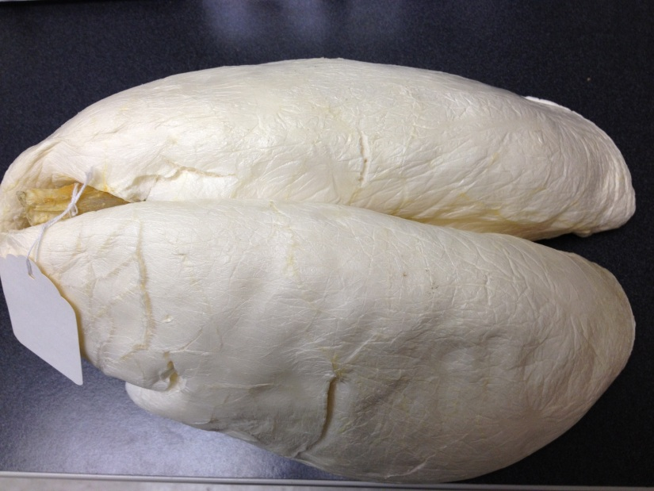
Trachea and Lung

Slide 7
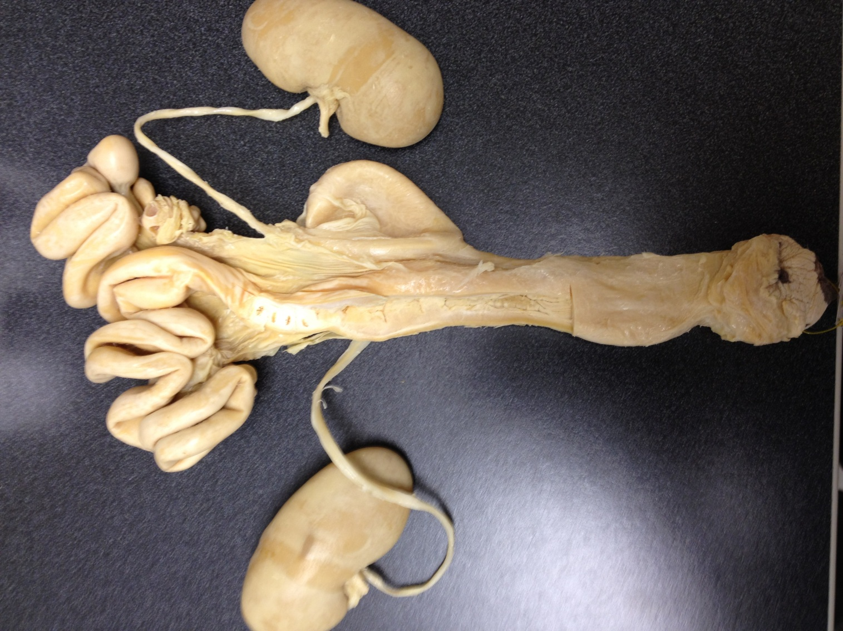
Kidney
Ovary
Cervix
Uterus
Kidney

Slide 8
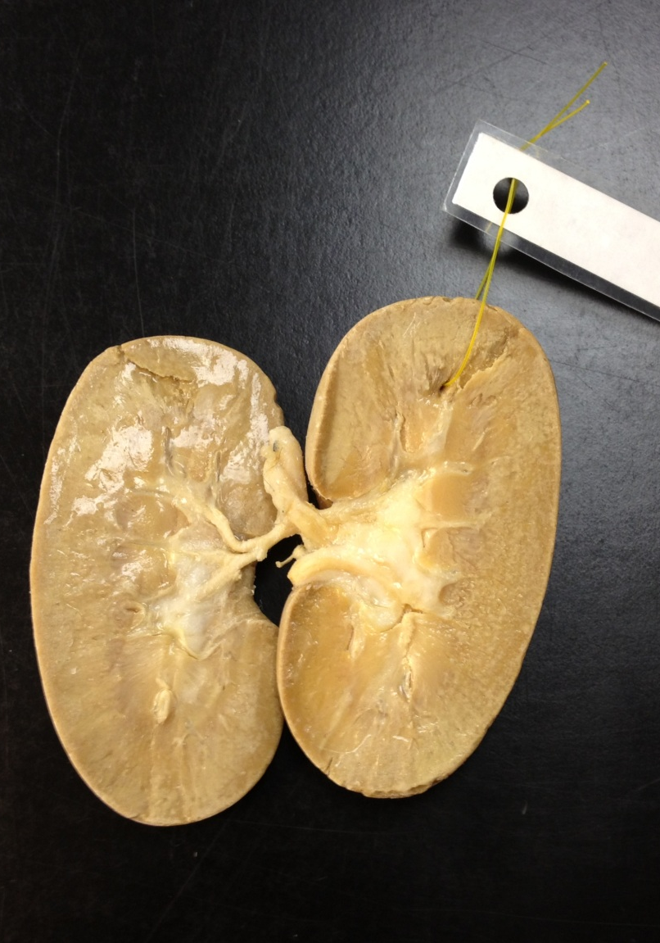
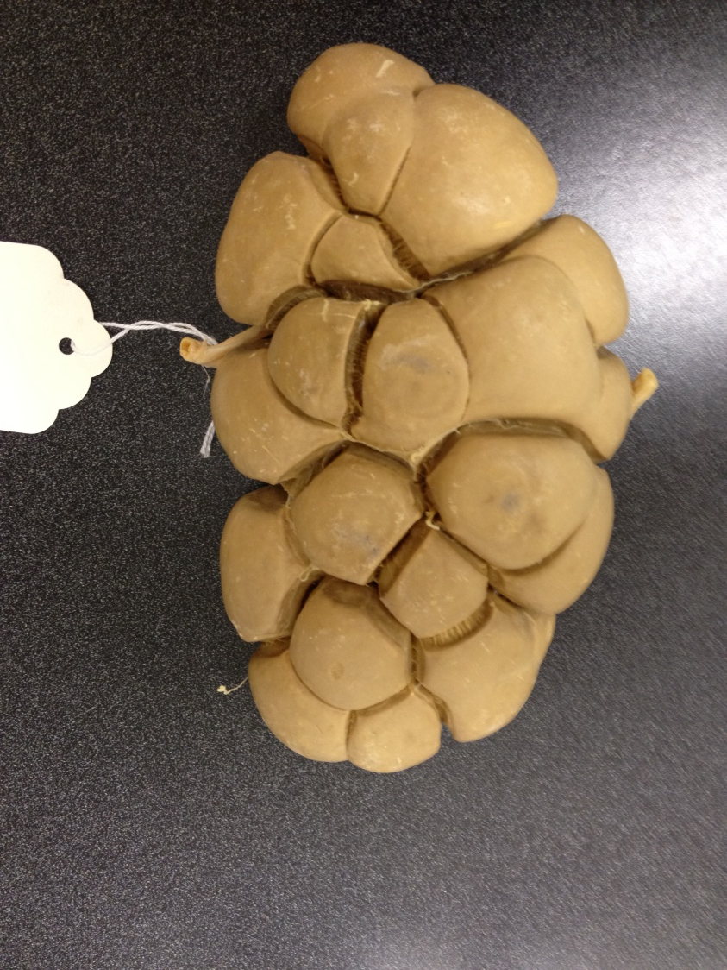
Kidney

Slide 9
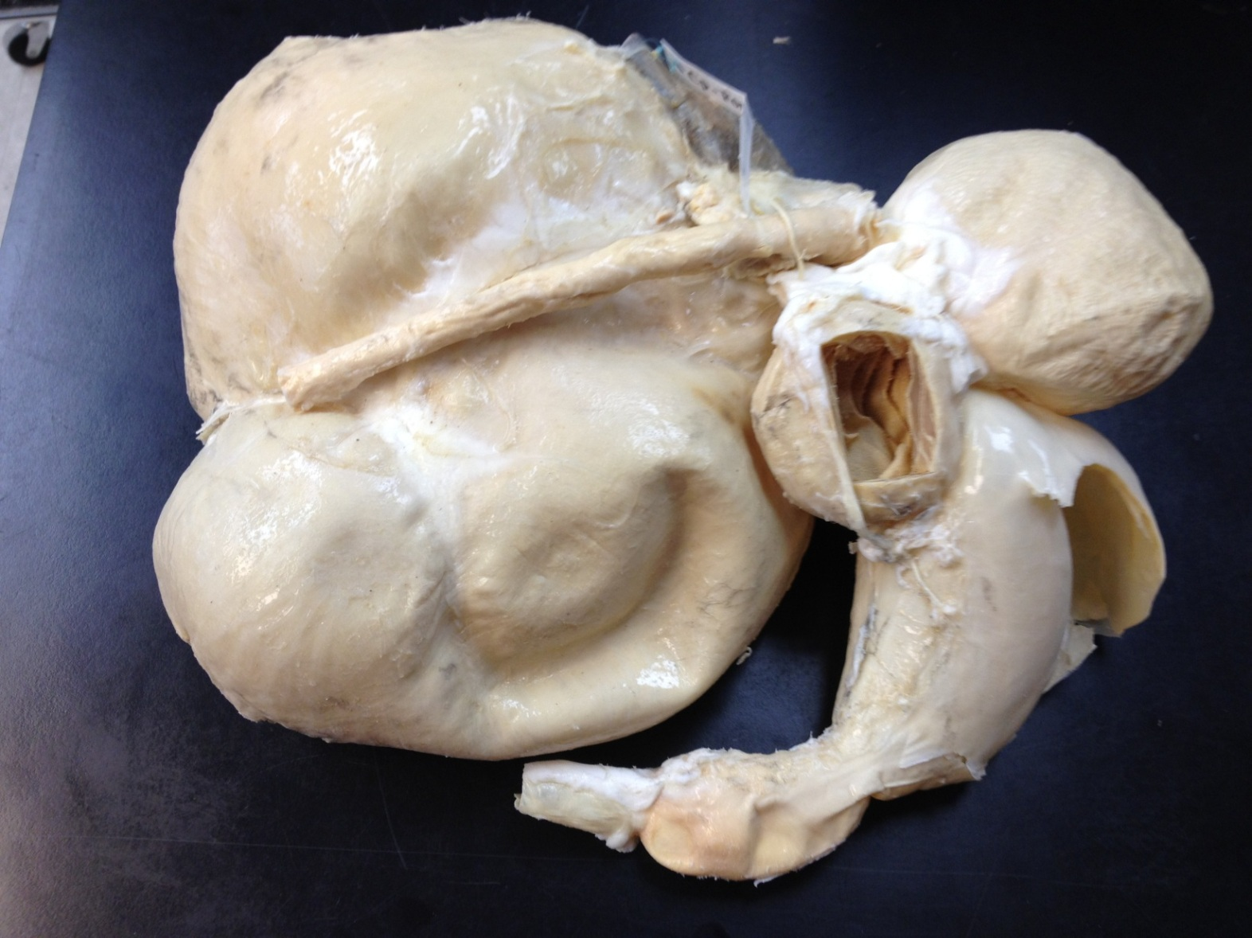
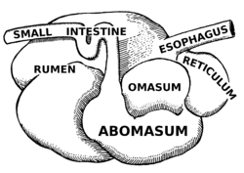
Stomach System-Ruminant

Slide 10
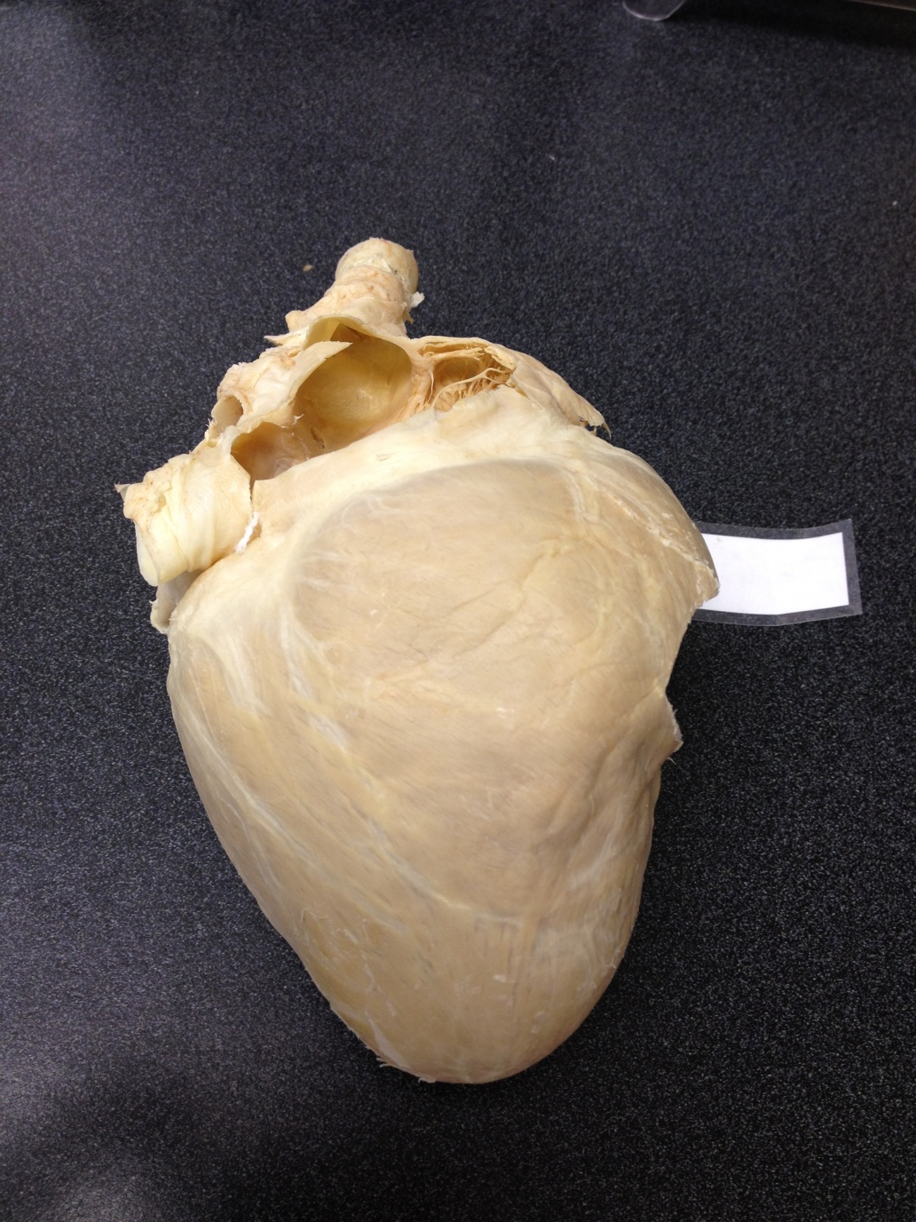
Heart

