Slide 1
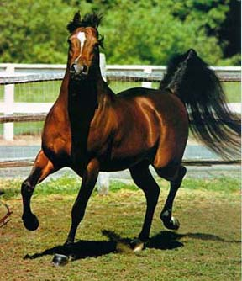
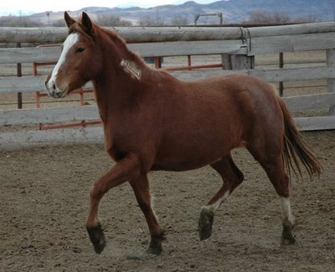
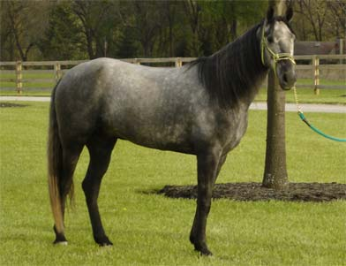
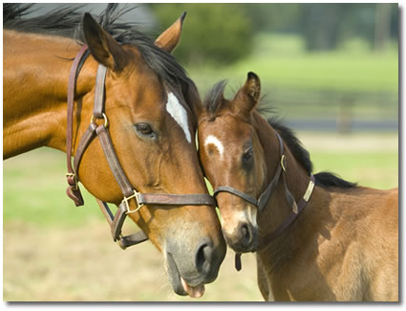
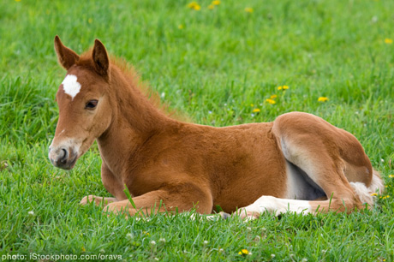
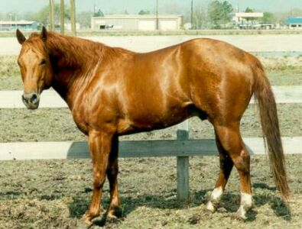
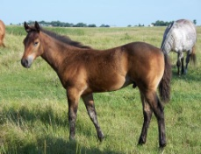
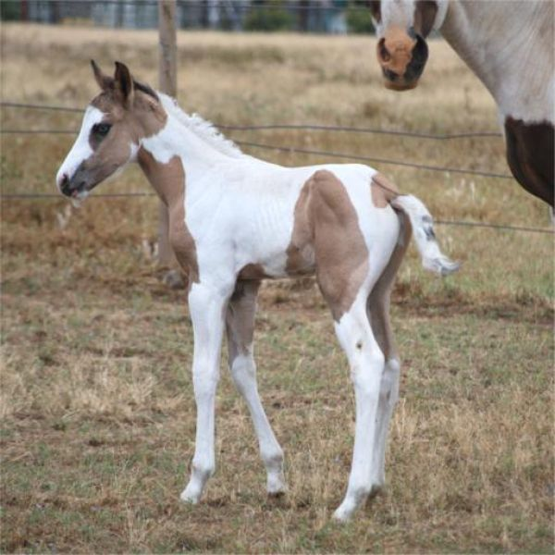
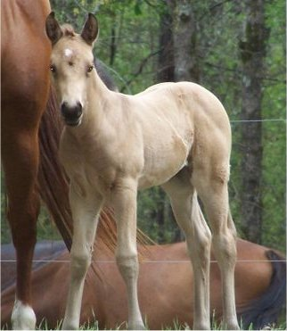
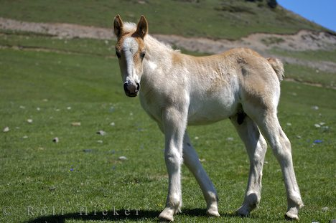
Equine

Slide 2
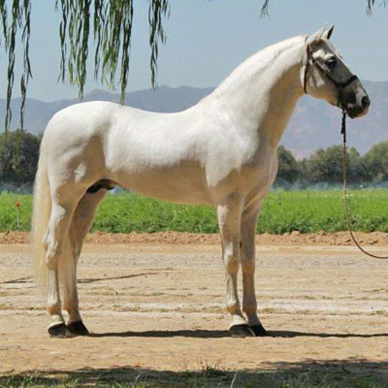
Andalusian
From Spanish Province of Andalusia
Distinguished appearance, usually appearing in the colors white and light gray and occasionally bay.
Flat or slightly convex nose, small ears and its head is set on a substantial neck

Slide 3
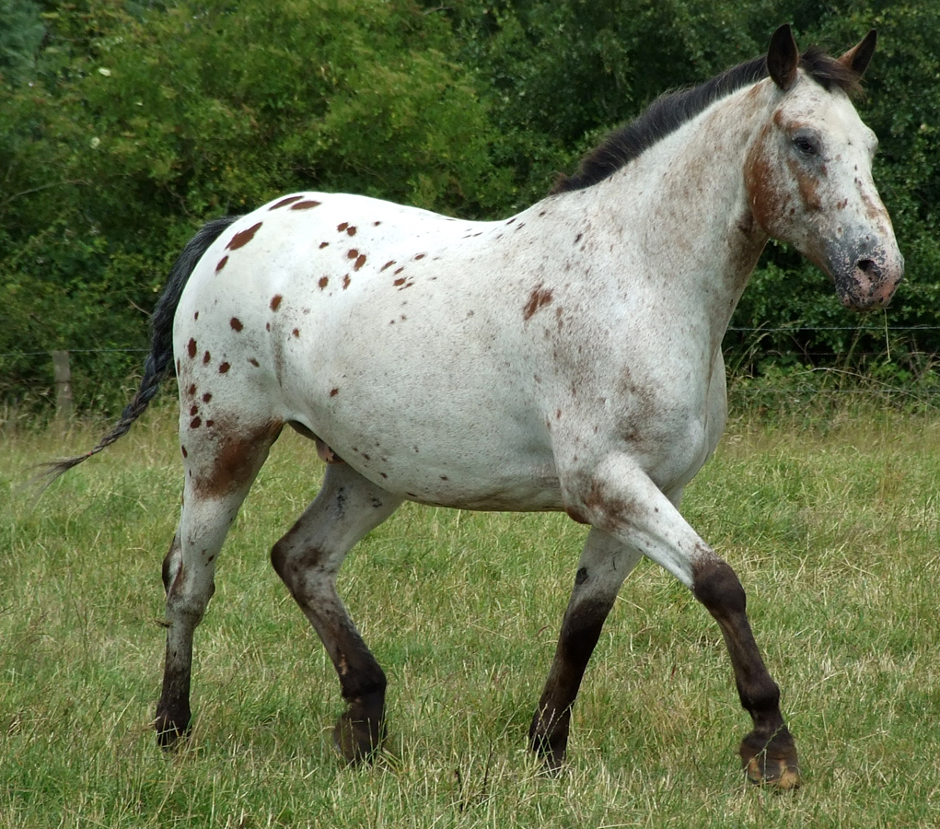
Appaloosa
Developed in the Palouse River Country of the Northwest
Three distinctive characteristics: the eye is encircled by white; the skin is mottled irregularly with black and white, particularly around muzzle; hooves are narrowly striped vertically in black and white.
General purpose riding horse

Slide 4
Arabian
From Arabia
Unsurpassed reputation for endurance
Solid colors are preferred: bay, brown, chestnut, gray and black

Slide 5
Belgian
From Belgium
Predominant color is light sorrel with flaxen mane and tail.
Easy to handle and very strong but less leg action than other breeds

Slide 6
Buckskin
Originated from the Spanish Sorraia
Color is an indication of the superior genetic heritage they possess
Noted for their superior qualities and strength

Slide 7
Clydesdale
From Scotland
Extensive white face and leg markings together with the “feathering” on the lower legs are very distinctive and create a bell bottomed effect.
Lighter weight than the Percherons and Belgians though just as tall.

Slide 8
Dutch Draft
Originated in Holland
Used for heavy draft and farm work
Should have a straight profile, short, lively ears, a strongly muscled front, good withers, a heavily muscled loin and hind quarters, with good muscle in the legs and good feet
Coat color is usually chestnut, bay or gray, and sometimes black

Slide 9
Dutch Warmblood
Warmblood sport horse breed
Most are black, brown, bay, chestnut, or grey, and white markings are not uncommon.
Long legged with a smooth topline and dry, expressive head.

Slide 10
Friesian
From Friesland in the northern Netherlands
Very long mane and tail that are never cut
Color is always black and only a white star on the forehead is permissible

Slide 11
Hackney
From England
May be any solid color including bay, brown, chestnut, and black. They often have white markings
Eyes and ears are expressive and should show alertness. They have a well shaped head with a slightly convex nose.

Slide 12
Hanoverian
From Germany
One of the oldest, most numerous and most successful warmblood breeds
Chestnut, bay, brown, black and gray

Slide 13
Lipizzaner
From Spain
Grey is the dominant color of the Lipizzaner today. They are born dark, black-brown, brown or mouse-grey and turn white/Grey between ages 6-10.
Tail is carried high and like the mane , is thick and long.

Slide 14
Miniature Horse
From Europe
Breed developed as pets for royalty in the 16th Century Europe
Should exhibit same physical characteristics of horse relative to body size

Slide 15
Mustang
Feral horse now found in the Western United States
Full range of colors found in horses

Slide 16
Paint
From the United States
Original registry established in 1963 for Quarter Horse with too much white
Two basic color patterns: tobiano and overo

Slide 17
Quarter Horse
From United States
Developed as a saddle horse with great speed over short distances
The working cow horse of the ranches of the Southwest and West.

Slide 18
Shetland Pony
From Scotland
May be draft or light horse type
Maximum height of 11.2 hands

Slide 19
Shire
Draft horse native to central England
Can be black, bay or gray
Widely used as a war horse and was well adapted to carry the excessive weight of armor.

Slide 20
Tennessee Walking Horse
From Tennessee
General purpose horse for riding, driving and farm work
Capable of naturally over striding

Slide 21
Thoroughbred
From England
Ideal Thoroughbred can not be described, “they run in all shapes and sizes”
Famous stallions include Secretariat, Northern Dancer and Bold Ruler

