Slide 1
Parasites

Slide 2
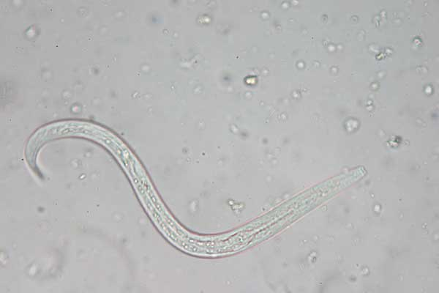
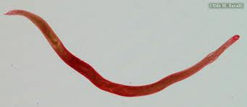
Ancylostoma caninum-Hookworm
Egg
Larvae
Adult

Slide 3
Ancylostoma braziliense-hookworm
Egg
Adult
Larvae

Slide 4
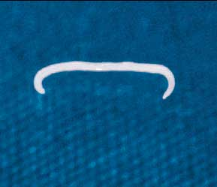
Ancylostoma tubaeforme-hookworm
Egg
Larvae
Adult

Slide 5
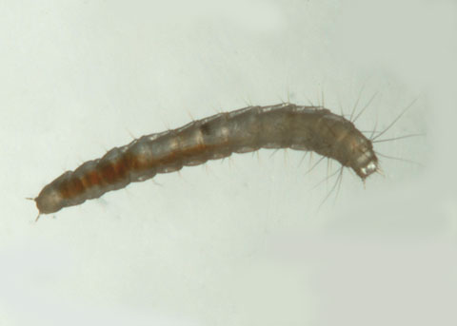
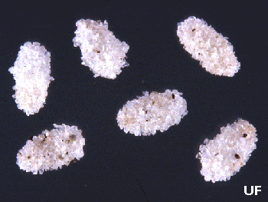
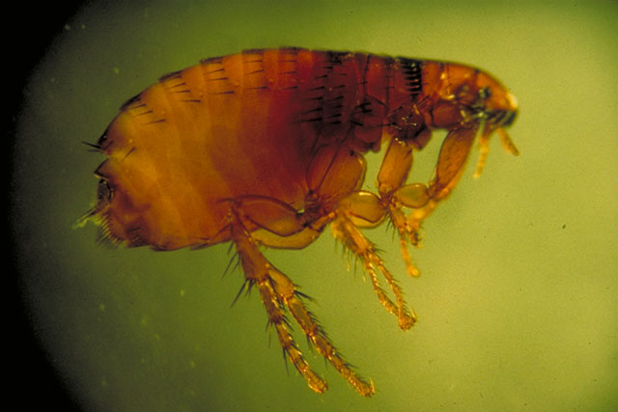
Ctenocephalides felis-flea
Egg
Larvae
Pupae
Adult

Slide 6
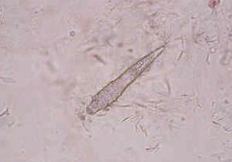
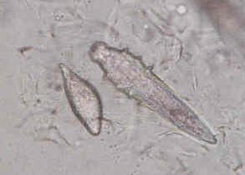
Demodex-mite
Egg
Nymph
Larvae
Adult

Slide 7
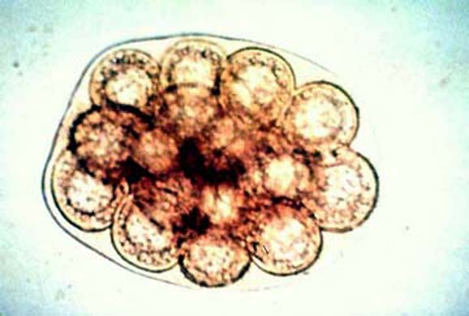
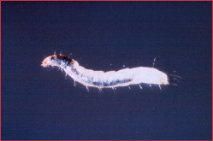
Dipylidium caninum- tapeworm dog and cat
Eggs digested
by larvae flea
Egg
Adult

Slide 8
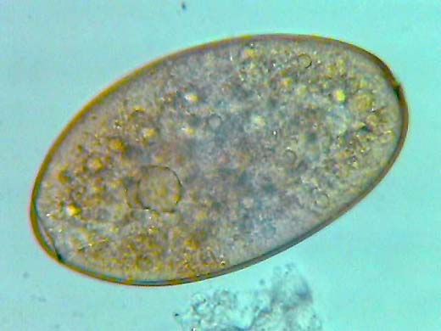
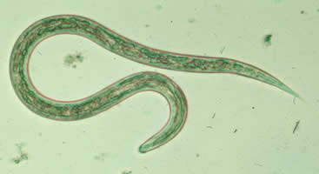
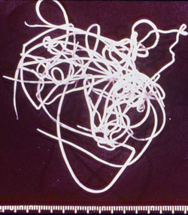
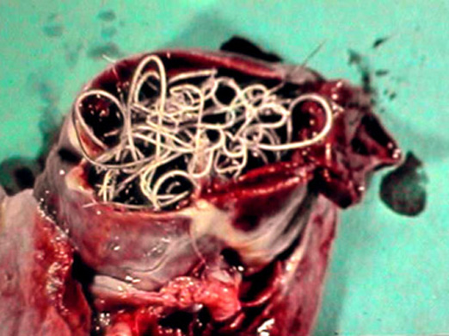
Dirofilaria immitis-heartworm
Egg
Larvae
Adult
Adult in heart

Slide 9
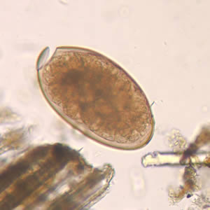
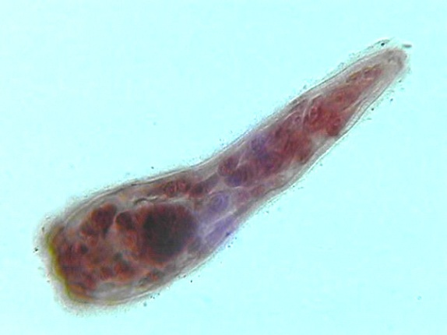
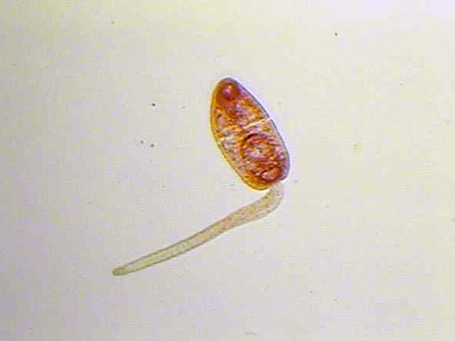
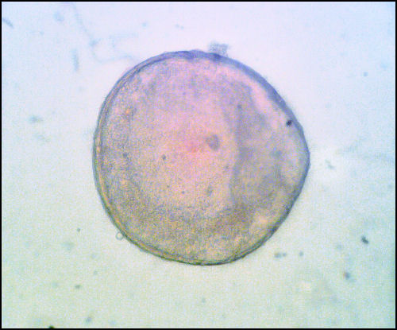
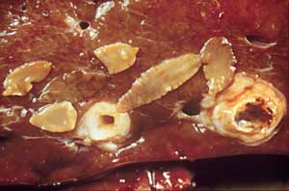
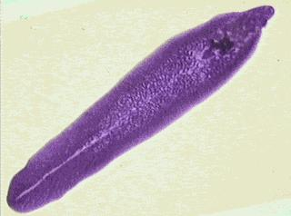
Fasciola hepatica-liver fluke of cattle and sheep
Egg
Miracidium
Cercariae
Adult
Metacercariae

Slide 10
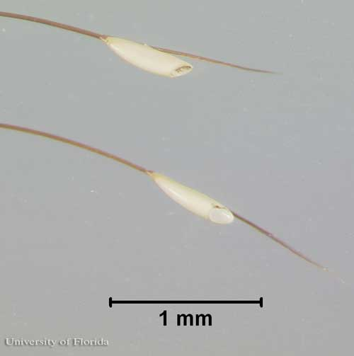
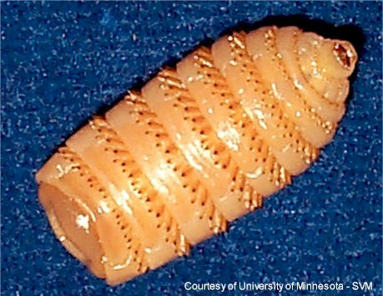
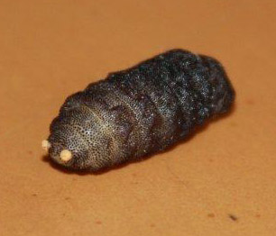
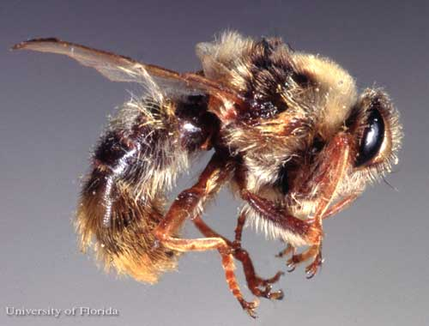
Gasterophilus hemorrhoidalis- bot fly of horse
Egg
Larvae
Pupae
Adult

Slide 11
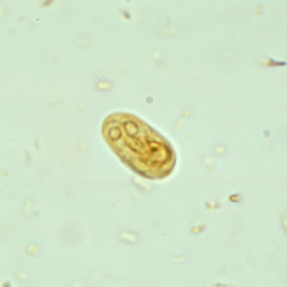
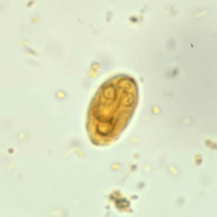
Giardia cyst

Slide 12
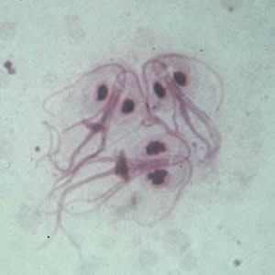
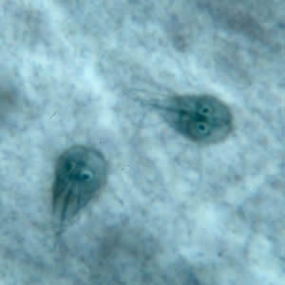
Giardia troph

Slide 13
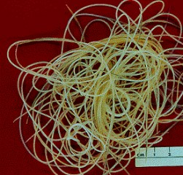
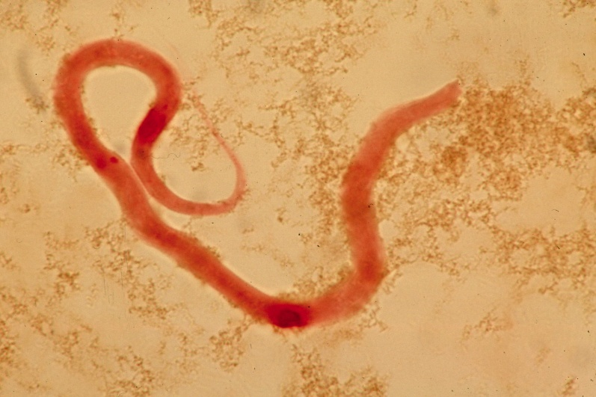
Heartworm adult

Slide 14
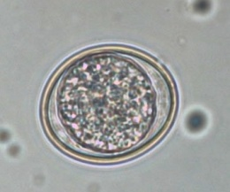
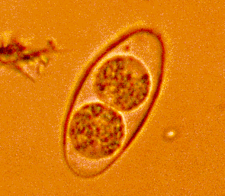
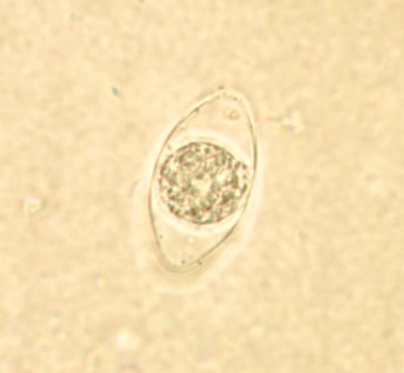
Isospora- dog and cat protozoa
Oocysts
Immature oocysts
with sporoblasts
Mature
Oocysts w/
Sporozoites
Immature oocysts
with sporocysts

Slide 15
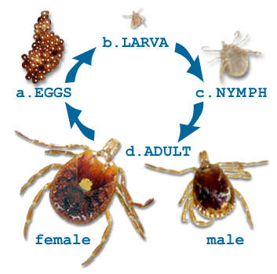
Ixodidae- hard tick

Slide 16
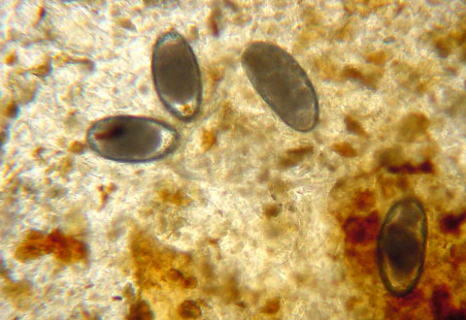
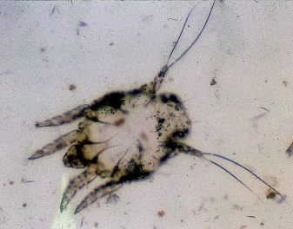
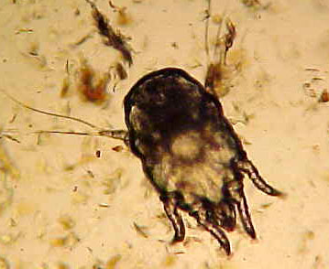
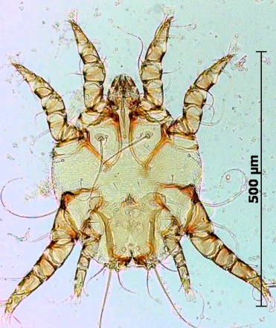
Otodectes-ear mite
Eggs
Larvae
Nymph
Adult

Slide 17
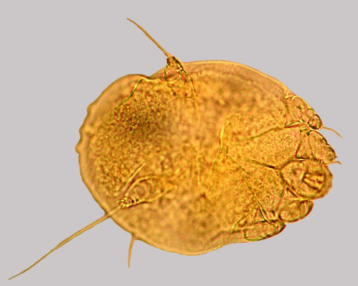
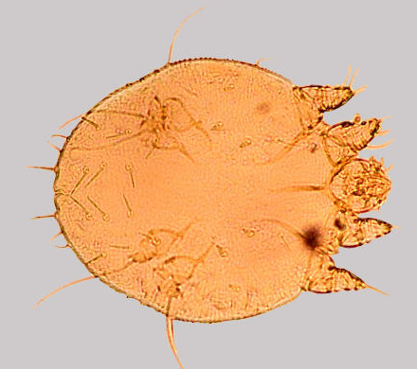
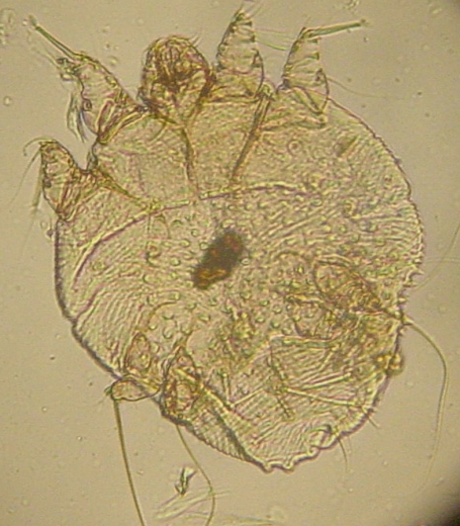
Sarcoptes-mite
Egg
Nymph
Larvae
Adult

Slide 18
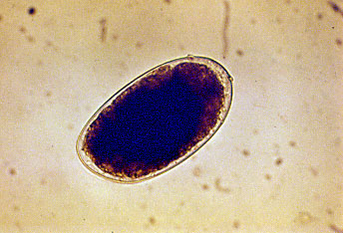
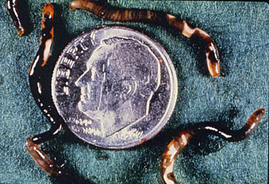
Stephanurus dentatus- kidney worm in swine
Egg
Adult

Slide 19
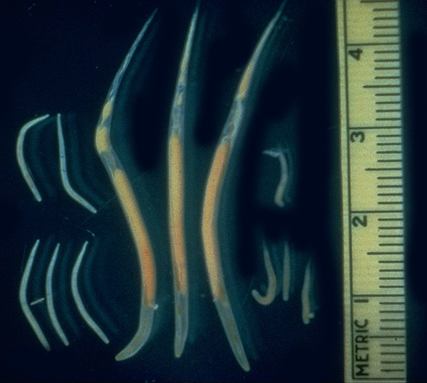
Strongyloides westeri-intestinal threadworms of horse
Egg
Larvae
Adult

Slide 20
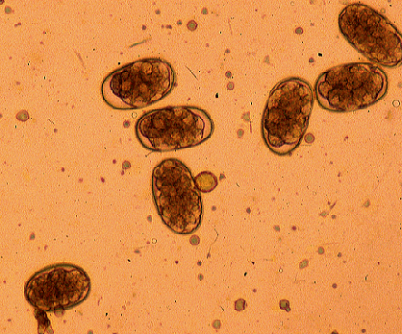
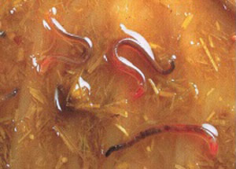
Strongylus vulgaris-large strongle of the horse
Eggs
Adult

Slide 21
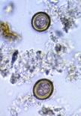
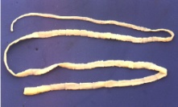
Taenia pisiformis- tapeworm dog
Adult
Egg

Slide 22
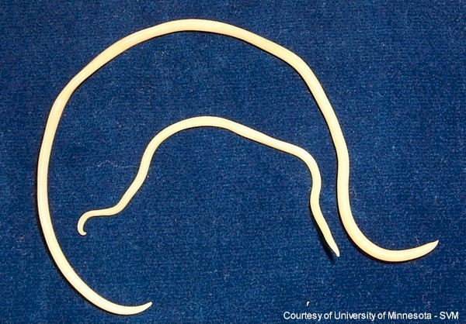
Toxocara- adult round worm

Slide 23
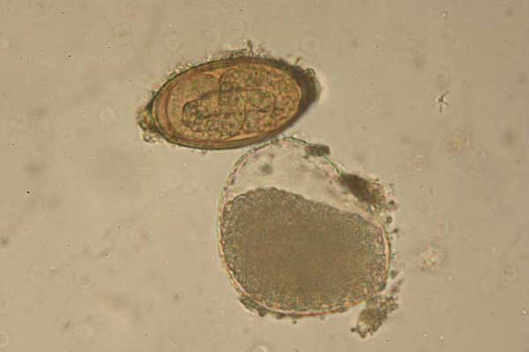
Trichuris vulpis- whipworm
Egg
Larvae
Adult

