Slide 1
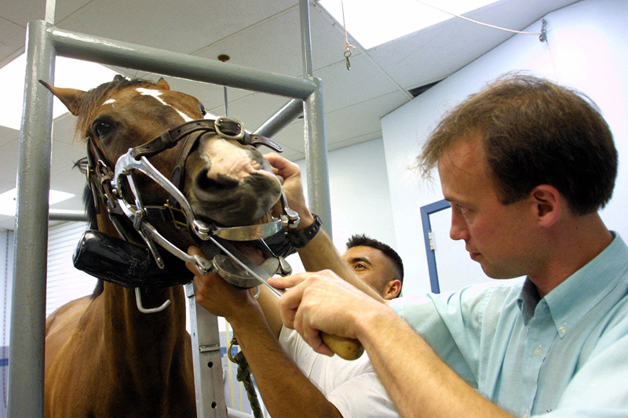
Vet CDE Equipment

Slide 2
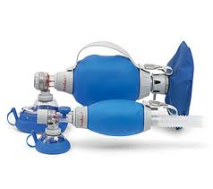
Ambubag - 100

Slide 3
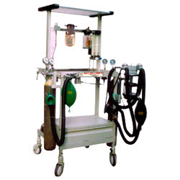
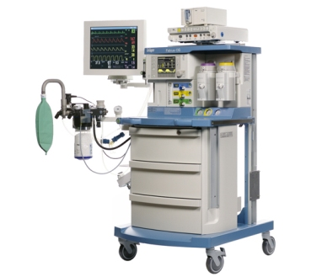
Anesthetic Machines 101

Slide 4
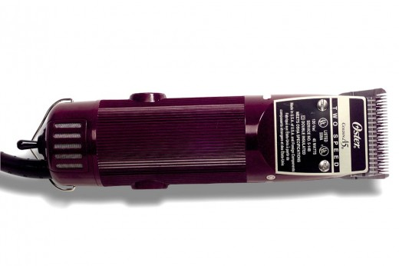
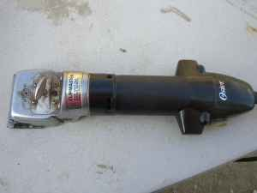
Animal Clipper - 102

Slide 5
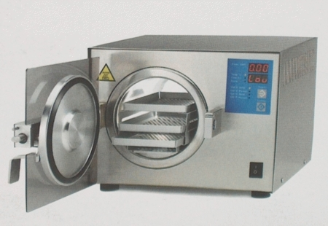
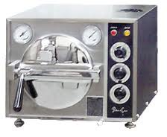
Autoclave - 103

Slide 6
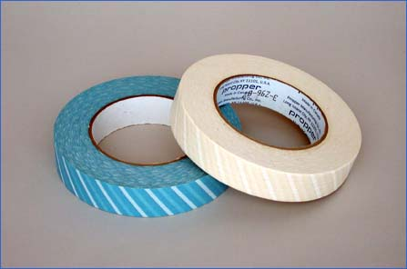
Autoclave Tape Indicator - 104

Slide 7
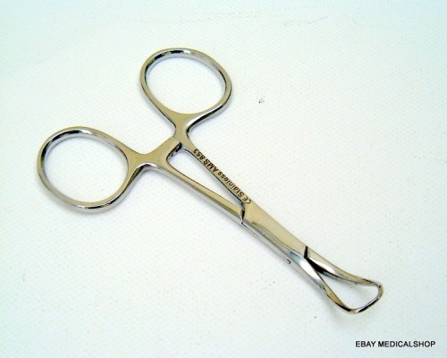
Backhaus Towel Clamps - 105

Slide 8
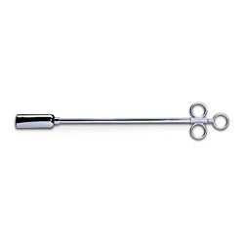
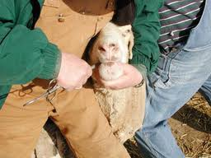
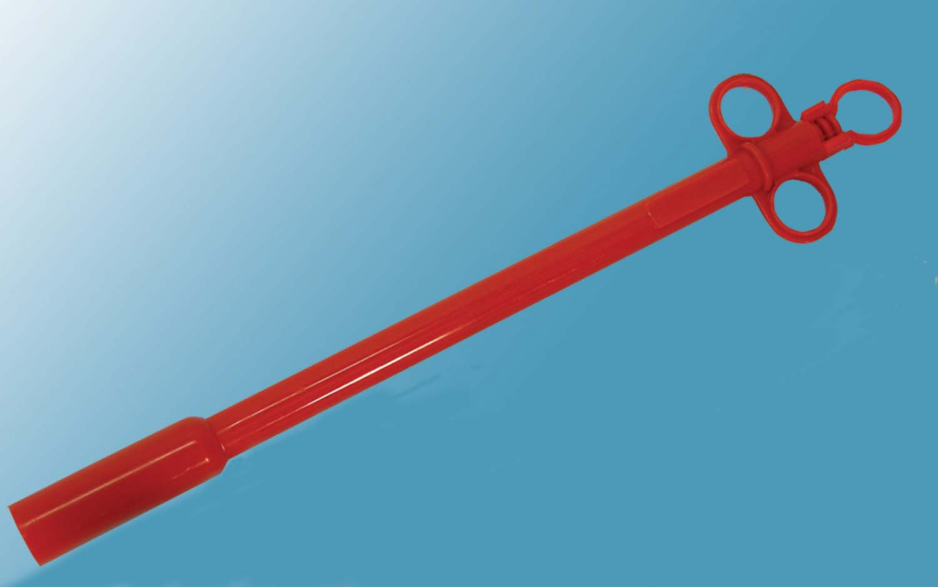
Balling Gun - 106

Slide 9
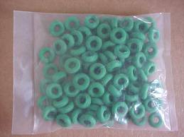
Bands (castration/docking: 107

Slide 10
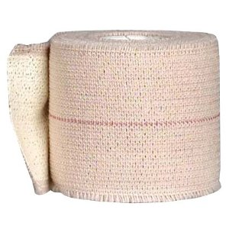
Bandaging Material Elastikon - 108

Slide 11
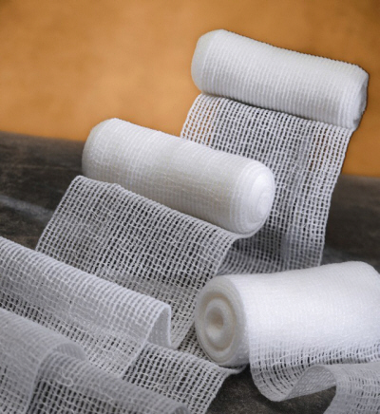
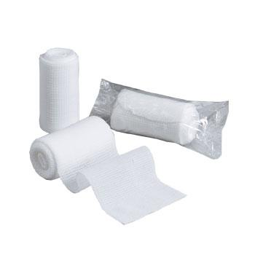
Bandaging Material Roll Gauze - 109

Slide 12
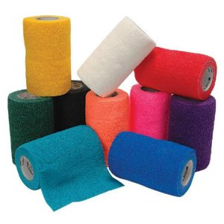
Bandaging Material – Vet Wrap 110

Slide 13
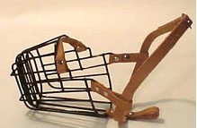
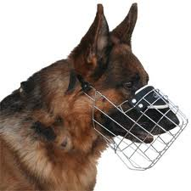
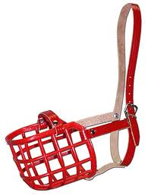
Basket Muzzle 111

Slide 14
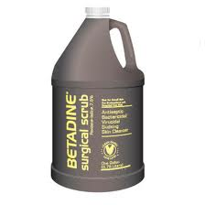
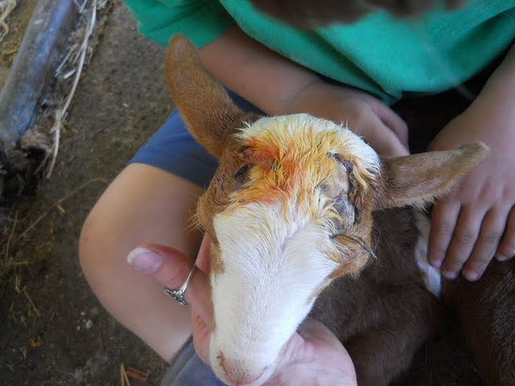
Betadine - 112

Slide 15
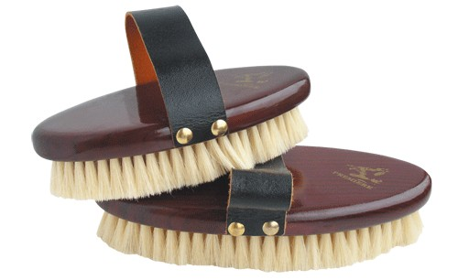
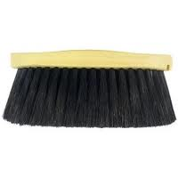
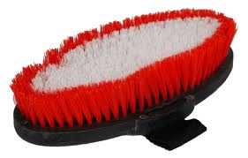
Brush body –Soft Bristle 113

Slide 16
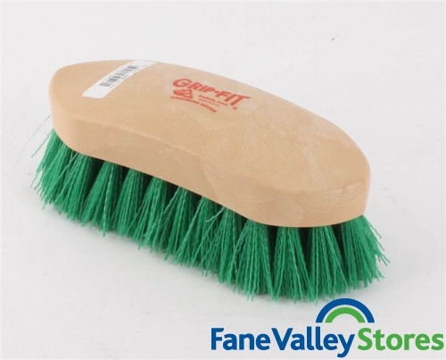
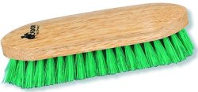
Brush – Dandy –stiff bristle 114

Slide 17
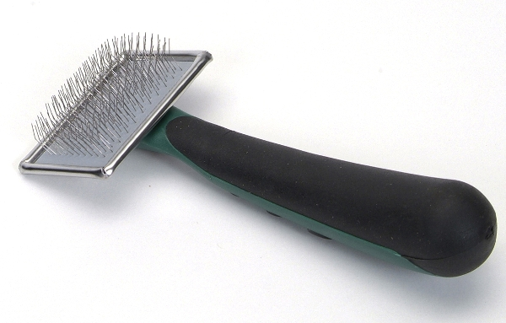
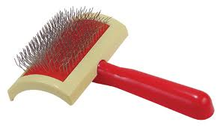
Brush –Slicker - 115

Slide 18
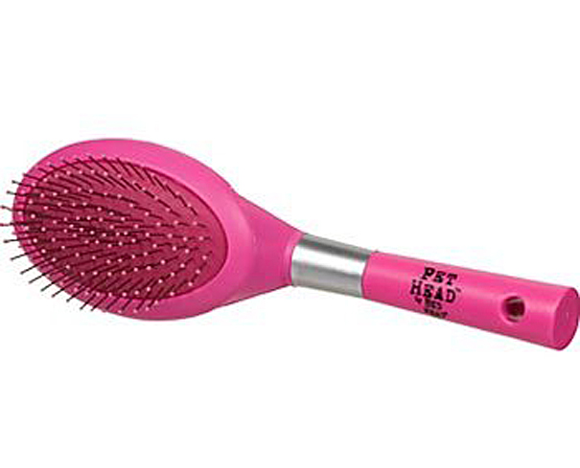
Brush – Pin 116

Slide 19
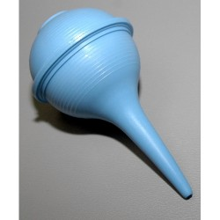
Bulb syringe 117

Slide 20
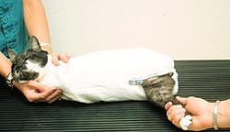
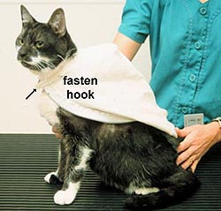
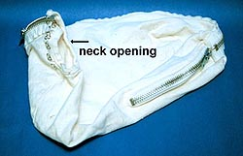
Cat Bag 118

Slide 21
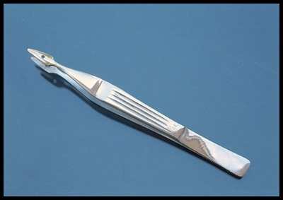
Carmalt Splinter Forceps 119

Slide 22
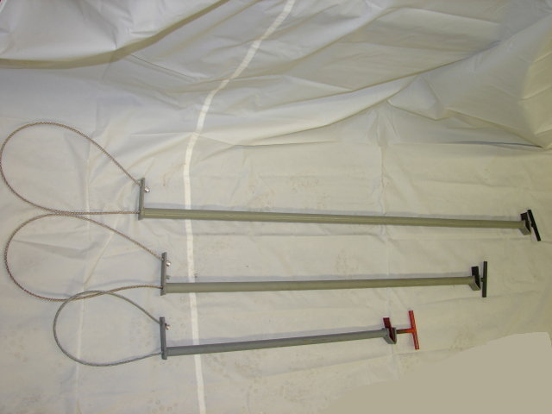
Catch pole (dog snare) 120

Slide 23
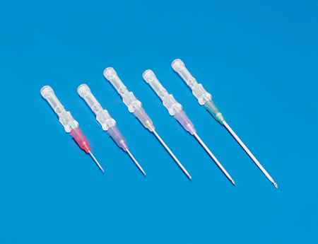
Catheter – IV 121

Slide 24
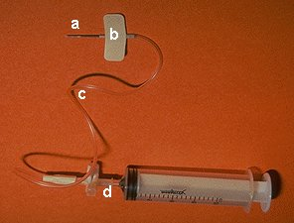
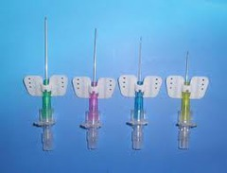
Butterfly Catheter-122

Slide 25
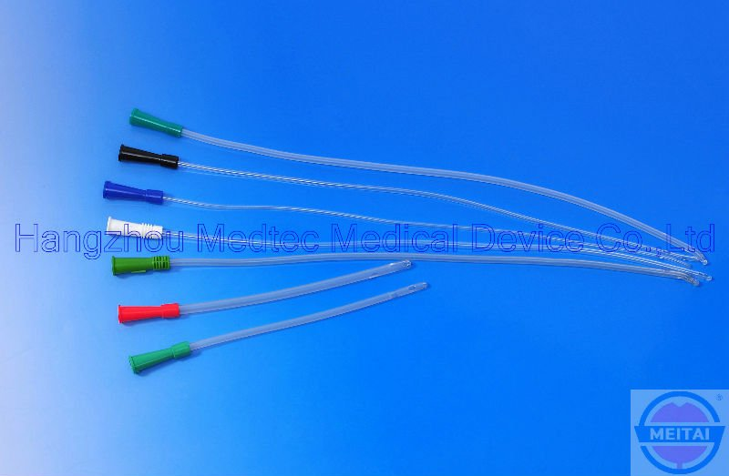
Catheter Urine 123

Slide 26
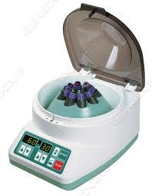
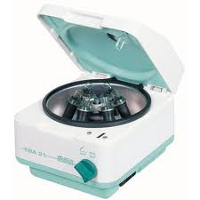
Centrifuge 124

Slide 27
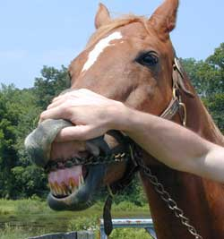
Chain Twitch 125

Slide 28
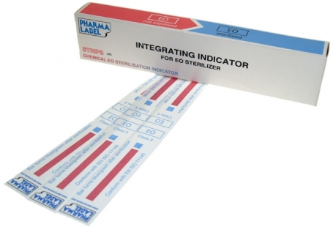
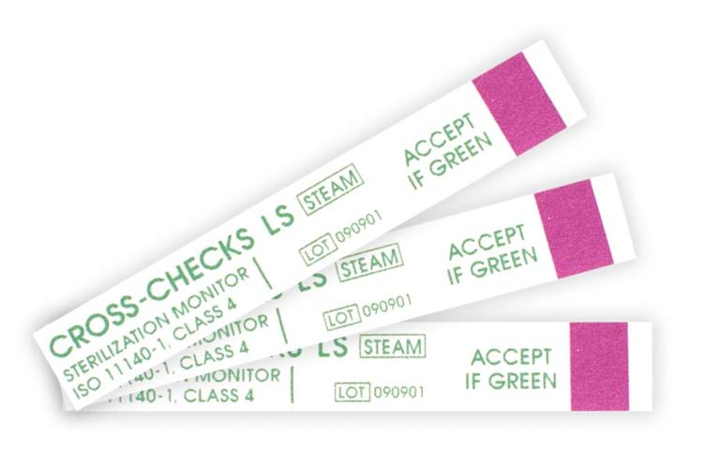
Chemical Sterilization Indicator Strips 126

Slide 29
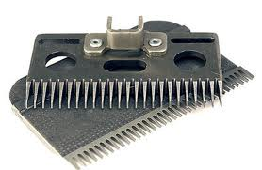
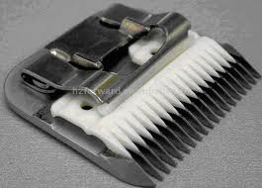
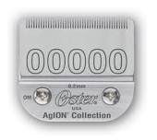
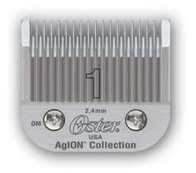
Clipper Blades 127

Slide 30
Clipper Comb 128

Slide 31
Surgical Drapes 129

Slide 32
Cold Sterile Tray 130

Slide 33
Comb – Curry 131

Slide 34
Comb – Flea 132

Slide 35
Comb – Scotch 133

Slide 36
Cover Slips 134

Slide 37
Dehorner – Barnes 135

Slide 38
Dehorner – Electric 136

Slide 39
Dehorner – Scoop or Tube - 137

Slide 40
Dental Floats-138

Slide 41
Dental Retractor - 139

Slide 42
Dental Scaler - 140

Slide 43
Disposable hypodermic needles 141

Slide 44
Drench gun 142

Slide 45
Ear notcher 143

Slide 46
Ear Tag 144

Slide 47
Ear tag pliers 145

Slide 48
Elastrator 146

Slide 49
Elizabethian Collar 147

Slide 50
Emasculators 148

Slide 51
Endotracheal tubes 149

Slide 52
Fecal loop 150

Slide 53
Fealyzers 151

Slide 54
Feeding Tube for small animals 152

Slide 55
Fetal extractor 153

Slide 56
Fingertip toothbrush 154

Slide 57
Alligator Forceps-156

Slide 58
Allis tissue forceps-157

Slide 59
Babcock Forceps-158

Slide 60
Brown Adson Thumb Forceps-159

Slide 61
Crile Forceps-160

Slide 62
Halstead mosquito forceps-161

Slide 63
Kelly forceps-162

Slide 64
Rat Tooth Thumb Forceps-163

Slide 65
Mouth Gag Speculum Small-164

Slide 66
Gag Speculum

Slide 67
Mouth Gag Speculum Large-165

Slide 68
Gavage Needle-166
Can be plastic as well- used for feeding rodents

Slide 69
Gravity Feeder/J tube-167

Slide 70
Halter-168

Slide 71
Head Chute-169

Slide 72
Hog Snare-170

Slide 73
Hoof Knife-171

Slide 74
Hoof Nippers-172

Slide 75
Hoof Pick- 173

Slide 76
Hoof Rasp-174

Slide 77
Hoof Trimmers-175

Slide 78
Humane Twitch-176

Slide 79
Id Tag Applicator-178

Slide 80
IV Fluids-179

Slide 81
IV Administration- 180

Slide 82
181-Laryngoscopes
Used to examine the larynx.

Slide 83
Lead Rope 182

Slide 84
183- lead shank
Lead Shank

Slide 85
Needle holder – Olsen-Hegar 185

Slide 86
Micrscope slides-186

Slide 87
Muzzle – Commercial 187

Slide 88
GUILLOTINE NAIL CLIPPERS-188

Slide 89
Nail clippers – plier 189

Slide 90
Obstetrical chain and handle-190

Slide 91
Ophthalmoscope 191

Slide 92
Otoscope-192

Slide 93
Paste gun 193

Slide 94
Pig tooth nipper-194

Slide 95
Pill Counting Tray 195

Slide 96
Radiology Personal Protective Equipment- 196

Slide 97
Rumen Magnet 197

Slide 98
Scalpel Blade-198

Slide 99
Scalpel handle -199

Slide 100
Bandage Scissors-200
Used to cut bandages.

Slide 101
Lister bandage scissors-201

Slide 102
Littauer Suture Removal Scissors-202

Slide 103
Scissor- Mayo Dissecting-203

Slide 104
Scissors- Metzenbaum Dissecting-204

Slide 105
Shedding blade-205

Slide 106
Silver nitrate stick-206

Slide 107
Small Animal Oxygen Cage-207

Slide 108
Snook ocariohysterectomy hook-208

Slide 109
Sheeze chute-209

Slide 110
Staple Remover-210

Slide 111
Steel lift table-211

Slide 112
Stethosope-212

Slide 113
Surgical cap-213

Slide 114
Surgical Gloves-214

Slide 115
Surgical Gown-215

Slide 116
Surgical mask-216

Slide 117
Surgical Tray-217

Slide 118
Suture Materials

Slide 119
Suture needles -219

Slide 120
Suture Wire Cutting Scissors-220

Slide 121
Syringe- leur lock-221

Slide 122
Syringe- Slip Tip- 222

Slide 123
Syringe- Automatic, Muti-dose- 223

Slide 124
Tattooing instrument- small & Large- 224

Slide 125
Tourniquet-225

Slide 126
Trocar & Cannula-226
Bloat Trocar and Cannula is a critical care product for use as a pain relief and anti-inflammatory product in horses. Supplied as a single Trocar and Cannula.

Slide 127
Weight Tape-227

Slide 128
Lead Gloves 042

